Slide 1
First Year
21st Century Scholars
Symposium

Slide 2
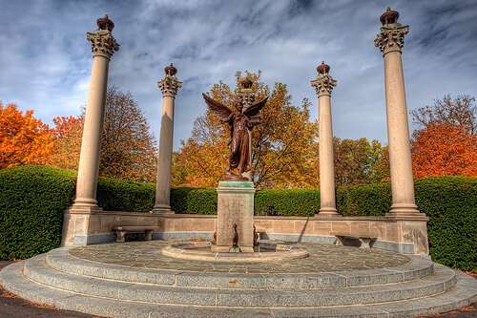
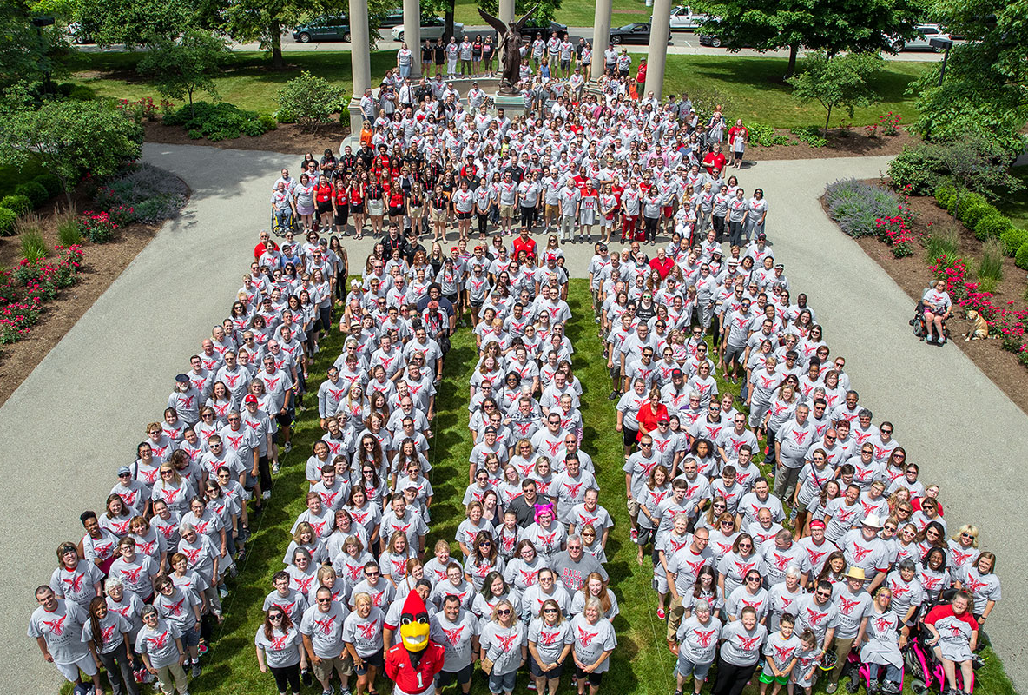
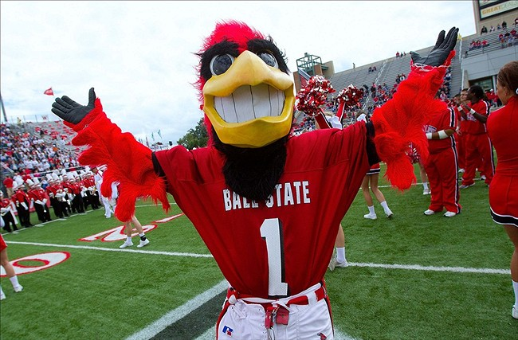
Welcome to Ball State University!

Slide 3
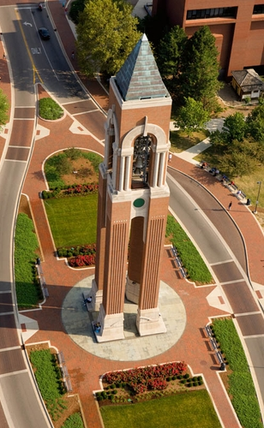
You will hear about:
Academic Advising
Career Center
Learning Center
Disability Services
Guardian Scholars/Independent Cardinals
Cardinal Central – Financial Aid
ScholarTrack
Cardinal Central – 21st Century Scholar Staff
EAB Navigate
ScholarCore

Slide 4
Academic Advising
Advisor for First Year
(0-29 credits / first academic year)
Transition to college
Course add / drop
UCC courses
Major / minor selection
Course selection and registration
Academic progress / GPA
DegreeWorks degree audit
Four-year plan
Success strategies
Referral to campus resources
Advisor for Upper Division
(30+ credits and one year completed)
Update four-year plan
Course selection and registration
DegreeWorks degree audit
Complete UCC/major/minor
Career goals
Immersive learning experience
Application for graduation
Degree completion

Slide 5

Academic Advising
First-Year Academic Advising (North Quad 339)
Drop-In Advising Hours
August 19-23 8:30-11 a.m. and 1-4 p.m.
(Or contact your advisor via email)
Other Important Dates
Sunday, August 25 Last day to add & drop classes
TBD-Week of August 26 Meet Your Advisor Event
Late September Begin advising appointments for spring
October 28 Last day to withdraw from full-term courses
November Registration for spring classes

Slide 6

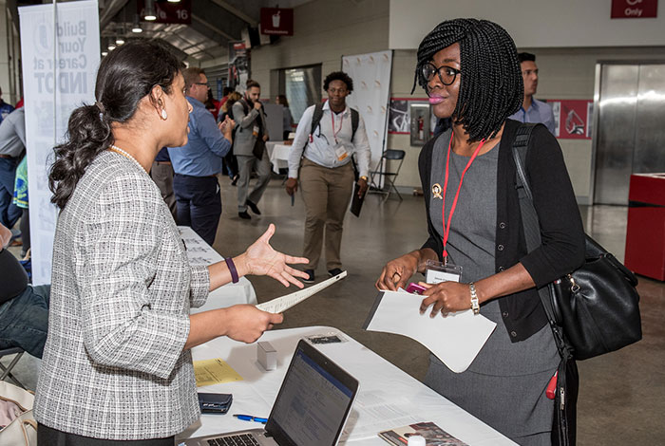
Career Center
Career Center (Lucina 220)
Scheduled Career Coaching Hours
Monday – Friday 9 a.m. – 4 p.m.
Important Dates
Wednesday, September 18th
Cardinal Job Fair - Worthen Arena – 11am-3pm
On-Campus Student Employment
If you are eligible for Federal Work Study, this is how that
funding is used = BSU paycheck – search in Cardinal Career
Link for job openings

Slide 7
Career Center
Career Coaches For YOUR Area
One on one coaching appointments that give you personalized career coaching
Connect you with employers, faculty, and alumni in your area
Other Career Coaches by specific major (Business, Arts and Sciences, Science and Health, Communications, Art, and Media, Exploratory students and students with disabilities)

Slide 8
Career Center
KEY Careers: Where Freshmen Meet to Develop a Successful Tomorrow
Explore how your interests, values, and skills relate to possible careers
Participate in our online experience
  Hosted in Canvas
  Will appear in your Canvas Dashboard in mid-September
Attend events throughout the year to meet other freshmen from around campus

Slide 9


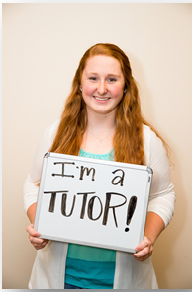

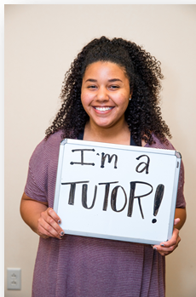
Learning Center
Appointment-Based Peer Tutoring
  In-person in NQ 350 or virtual via Zoom (Monday-Thursday, 10am-8pm; Friday, 10am-2pm)
  Visit bsu.navigate.eab.com to make a tutoring appointment.
    You can also download the Student Navigate app.
    You can also go to my.bsu.edu and click on “Navigate.”
  Written instructions are on our website at bsu.edu/learningcenter.
  You can start making appointments on the first day of the semester, Monday, August 19th. Tutoring begins that day!
  List of courses are on our website; here is a sampling…

Slide 10
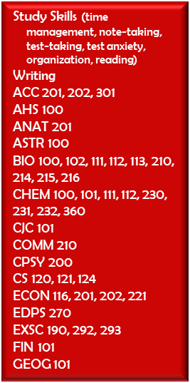
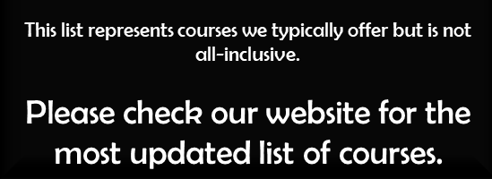
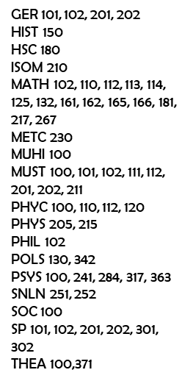
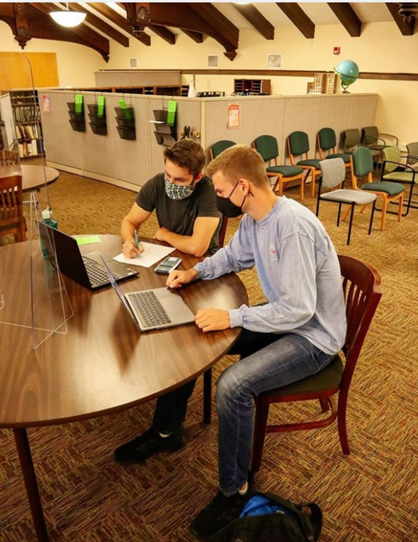
Learning Center

Slide 11
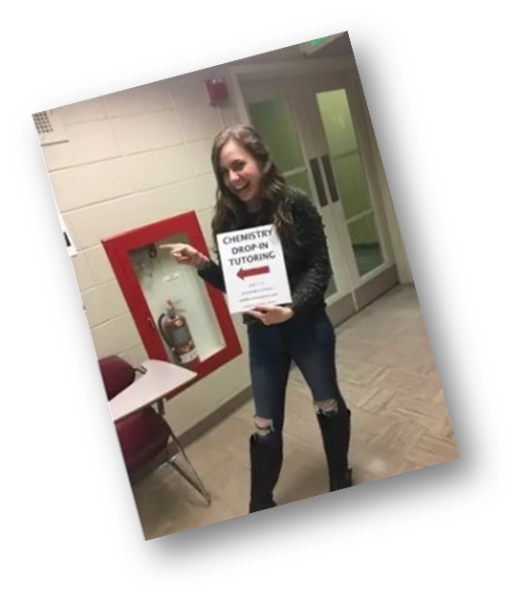

Learning Center
Drop-In Satellite Tutoring: no appointment necessary!
  MATH 102, 110, 112, 113, 114, 125, 132, 161, 165, 166 in RB (Robert Bell) 125, time TBA.
  CHEM 101, 111, 112 in FB (Foundations Building), room and time TBA.
  BIO 111 and 112 in FB, room and time TBA.
  Drop by and stay as long or short as you like!
  Supplemental Instruction (study sessions for specific courses)
  SI leaders hold 2-3 study sessions every week and create materials such as study guides, practice tests, and visual aids to help you learn the material.
  If you have an SI leader for your class, they will provide info the first week.

Slide 12
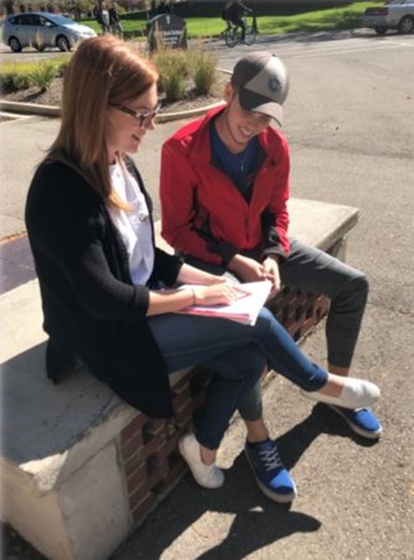
Learning Center
Study Skills Tutoring
Your study skills tutor can help you….
  Set academic goals and make plans to achieve them
  Get your class materials organized
  Learn how to manage your time
  Learn study skills such as reading your textbook faster and retaining more, note-taking, and test-taking.
  Find campus resources and feel at home on the Ball State campus!
  Sign up for study skills tutoring the same way you sign up for tutoring: visit bsu.navigate.eab.com.
Test Proctoring for Students with Disabilities
  Register with Disability Services first (call 765-285-5293 for more information)
  You may be able to take your exams in the Learning Center in our testing suite if you need extended time, a distracted-reduced environment, a reader, a scribe, or adaptive technology.
  Visit our website for all of this information and more! bsu.edu/learningcenter

Slide 13
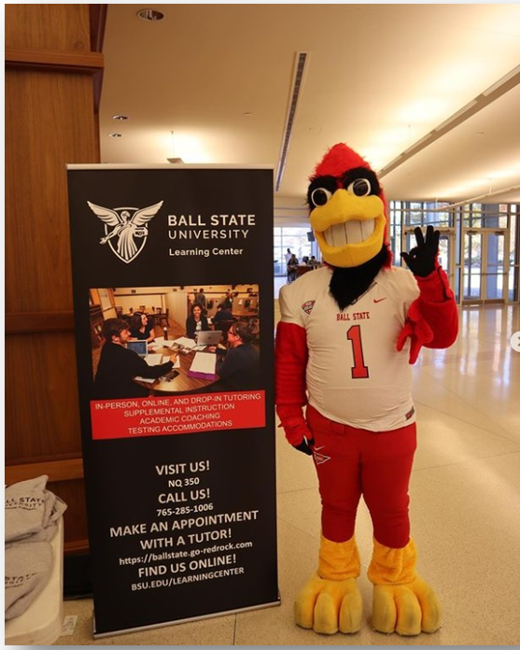
Learning Center
You don’t have to “prep” for a tutoring session or have specific questions. Just show up with your book and notes!
Your tutor will not think you are dumb. Many tutors have been tutored!
Use Navigate to make appointment.
Show up to NQ 350 or online (Zoom).
Get tutored.
Easy as that.
Meeting with a tutor is like getting help from a friend or classmate. It’s easy to make an appointment.
THERE IS NO NEGATIVE STIGMA!!!!

Slide 14

Disability Services
Process:
Disclose disability
Provide DS w/ documentation
Meet with DS staff to plan appropriate accommodations
Provide letters to faculty & talk to them about accoms
Talk to DS staff if issues arise
Contact info:
Student Center Room 116
dsd@bsu.edu
765-285-5293

Slide 15

Guardian Scholars
Our Mission
The Guardian Scholars is a university-sponsored, student support service for Ball State students who experienced foster care. Our mission is to promote equity & provide access to higher education for this vulnerable student group.
Program elements include: ​
  1:1 Holistic Support​
    Academic, Financial Aid, Food/Housing, Mental Health, Belonginess​
  Program Events
    Parties, seminars, gifts, supplies
  Scholarship Opportunity

Slide 16

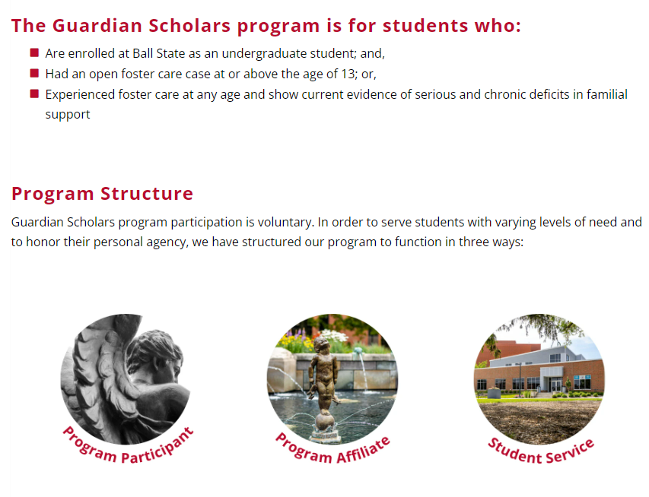
Guardian Scholars
  Phone: (765) 285-5538
  Email: gscholars@bsu.edu
  Web: bsu.edu/guardianscholars
  Offices:
  Multicultural Center, MC 206

Slide 17
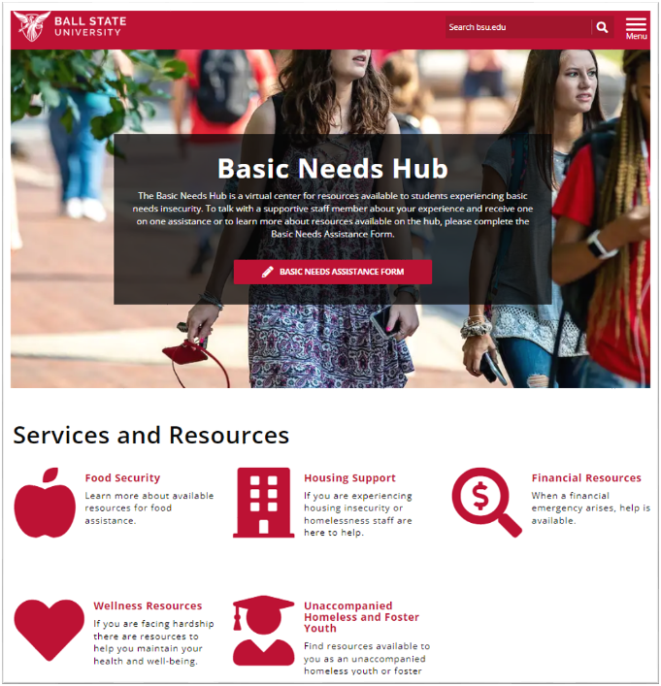
Independent Cardinals
Independent Cardinals is a support service for unaccompanied homeless youth and eligible Independent students, helping provide a central office and supportive staff to assist students in a successful transition to college and throughout their undergraduate education.
Seek support if you:
Are an unaccompanied homeless youth that qualifies as an
Independent student on the FAFSA
Are verified as McKinney-Vento eligible
Are a self-supporting youth at risk of or experiencing
housing insecurity or homelessness
Single Point of Contact (SPOC):
Tiffany Peters- tmpeters@bsu.edu (765)285-1545

Slide 18

Cardinal Central –
Financial Aid and Scholarships
What does my scholarship cover?
Tuition and regularly-assessed fees for full-time enrollment (12-18 hours)
How will my credit completion be tracked?
At the end of each semester, Ball State will report completed hours
(D- grade or higher) in ScholarTrack.
What is Satisfactory Academic Progress (SAP)?
Maintain a GPA consistent with university graduation requirements
Stay on pace to graduate (67%)
Check your status in your Financial Aid tab in Self Service Banner
  (765) 285-2222 – Student Center 120 – cardinalcentral@bsu.edu

Slide 19
21st Century Scholars
Using Your Scholarship
Covers tuition and regularly-assessed fees for full-time enrollment (12-18 hours) at Ball State University only
  Any enrollment over 18 hours is NOT covered
  Housing, textbooks, meal plans, etc. are NOT included
    - If you have other financial aid i.e. scholarships, grants or loans, they can be applied to housing or excess charges on your BSU bill
Provides up to 4 years (or 8 semesters) of tuition assistance toward an undergraduate degree
  Does NOT cover summer tuition or graduate school
  Once you earn your undergraduate degree, your scholar eligibility is complete even if you have not used all 8 semesters

Slide 20
21st Century Scholars
Maintaining Your Scholarship
In order to keep your 21st Century Scholarship while in college, you must:
  Be enrolled full-time (at least 12 credit hours)
    Do not drop below 12 credit hours – talk with your 21st Century Scholar Support Specialist ASAP
  Maintain Indiana residency
  Meet Satisfactory Academic Progress (SAP) as defined by Ball State University
  File the FAFSA on-time each year while in college – April 15th
  Complete 30 Credit hours each year

Slide 21
21st Century Scholars
College Credit Completion Requirement
  Think 15-to-Finish!
    15 credits each semester
    14 credits and 16 credits
    12 credits and 18 credits
  Dual Credit earned in high school and Advanced Placement credits CAN count toward the 30-hour credit completion requirement
    Dual credits must appear in ScholarTrack in order to count toward this requirement
    If your dual credits are not there now, wait a month and let us know
  You may use the summer to catch-up (not covered by your scholarship)
  Ask for Help & Don’t Give Up!

Slide 22

21st Century Scholars
ScholarTrack
Every scholar here should already have an account.
You will continue to use ScholarTrack throughout your college career.
If your ScholarTrack account has your high school email, you will want to update that information and make sure you have a Full User Account access
if you need to have your password reset call the
Scholar Support Center 888-528-4719

Slide 23
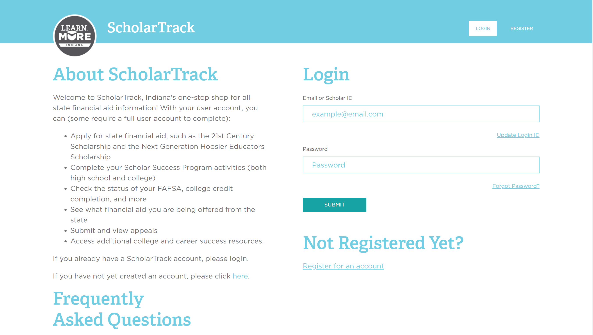
ScholarTrack
ScholarTrack Updates: Login

Slide 24
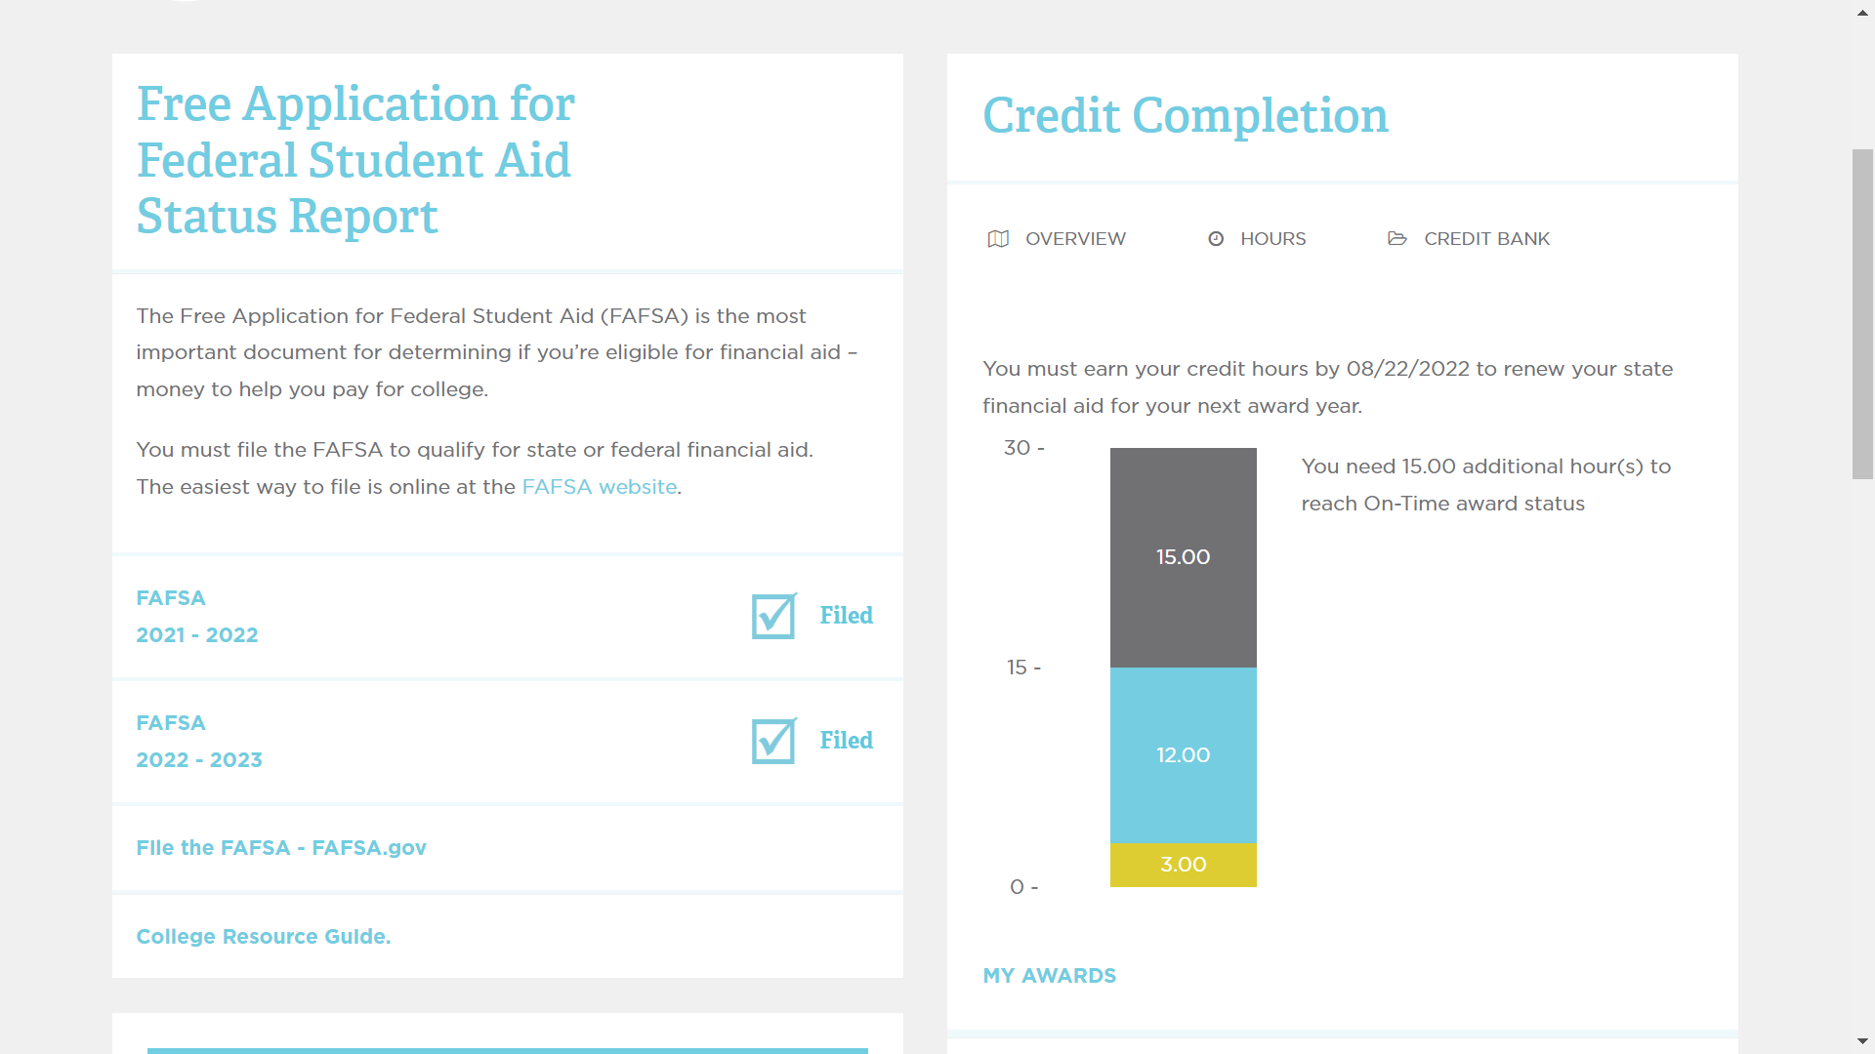
ScholarTrack
ScholarTrack Updates: Your Dashboard

Slide 25
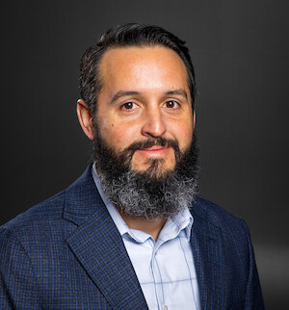
Cardinal Central -
21st Century Scholars Staff
Eric Bales
21st Century Scholar Success Coach
Cardinal Central
SC 120
Phone: 765-285-3312
eric.bales@bsu.edu
Jairett Boyce
Graduate Assistant​
Cardinal Central​
SC 120 ​ ​
jtboyce@bsu.edu
Innocent Ugochukwu
Graduate Assistant
Cardinal Central
SC 120
innocent.ugochukwu@bsu.edu

Slide 26
Cardinal Central
Student Center - Room 120
We will contact you about:
  Programs and events
  Academic alerts
  Institutional holds
  Course registration
  30-hour credit completion
  Academic probation
  EAB Navigate
We expect you to:
  Setup your voicemail
  Check your Ball State Email
  Meet when requested
    Before you make ANY decisions regarding your registration
    speak with us about the impact to your scholar award status!
    Contact us with any questions or concerns!
Our website has lots of information including FAQs
https://www.bsu.edu/about/administrativeoffices/epm/cardinal-central/additional-services/21st-century-scholars

Slide 27
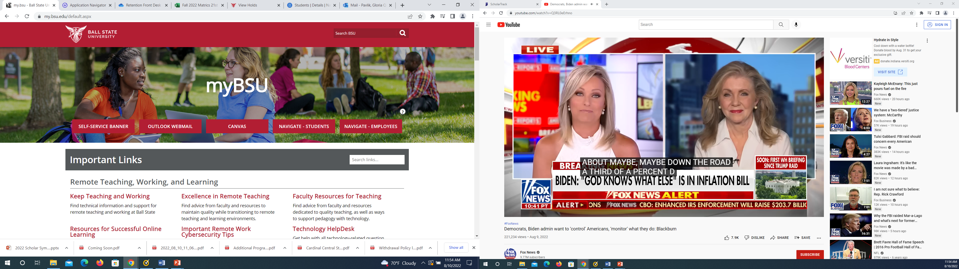
EAB Navigate
EAB Navigate is part of a university-wide strategic plan to increase academic success and
student retention. A great benefit of having EAB Navigate is the ability for faculty to issue early alerts/progress reports. This early alert progress reporting system is an intentional approach to outreach and support of students who are struggling academically early enough in the semester to help them find the resources they need to be successful at Ball State.

Slide 28
Navigate
Who will use Navigate? academic advisors, faculty, and Care Units such as Online and Strategic Learning, Learning Center, Cardinal Central… and STUDENTS (21st Century Scholar Support Specialists :Eric Bales, Innocent Ugochukwu, or Jairett Boyce)
How will we use it?
Appointments with advisors and the Learning Center
Notes
Progress Reports
Campaigns

Slide 29

ScholarCore
What is ScholarCore?
ScholarCore is an organization on campus. The purpose of this organization is to educate, and support Ball State University’s 21st century scholars. This organization also strives to give back to the Muncie community and make an impact in accordance with the Ball State University mission statement.

Slide 30
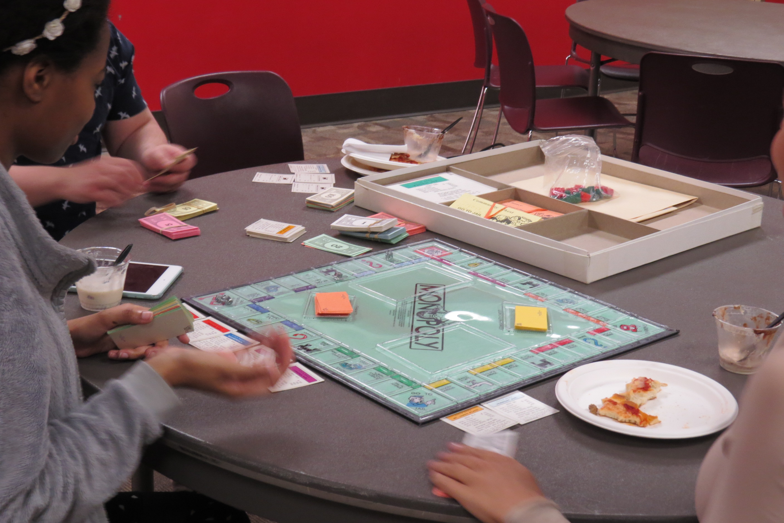
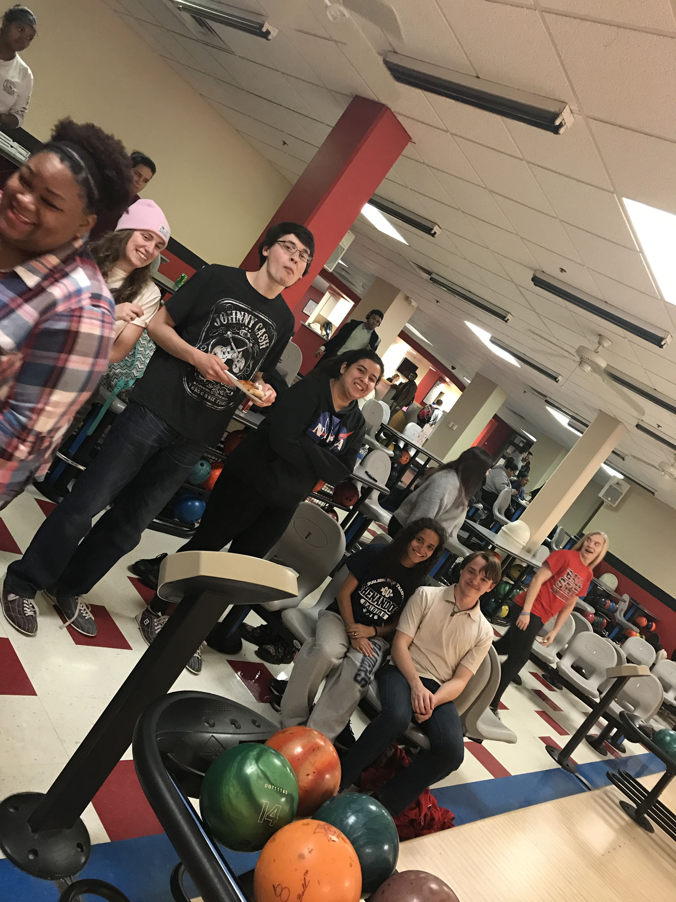
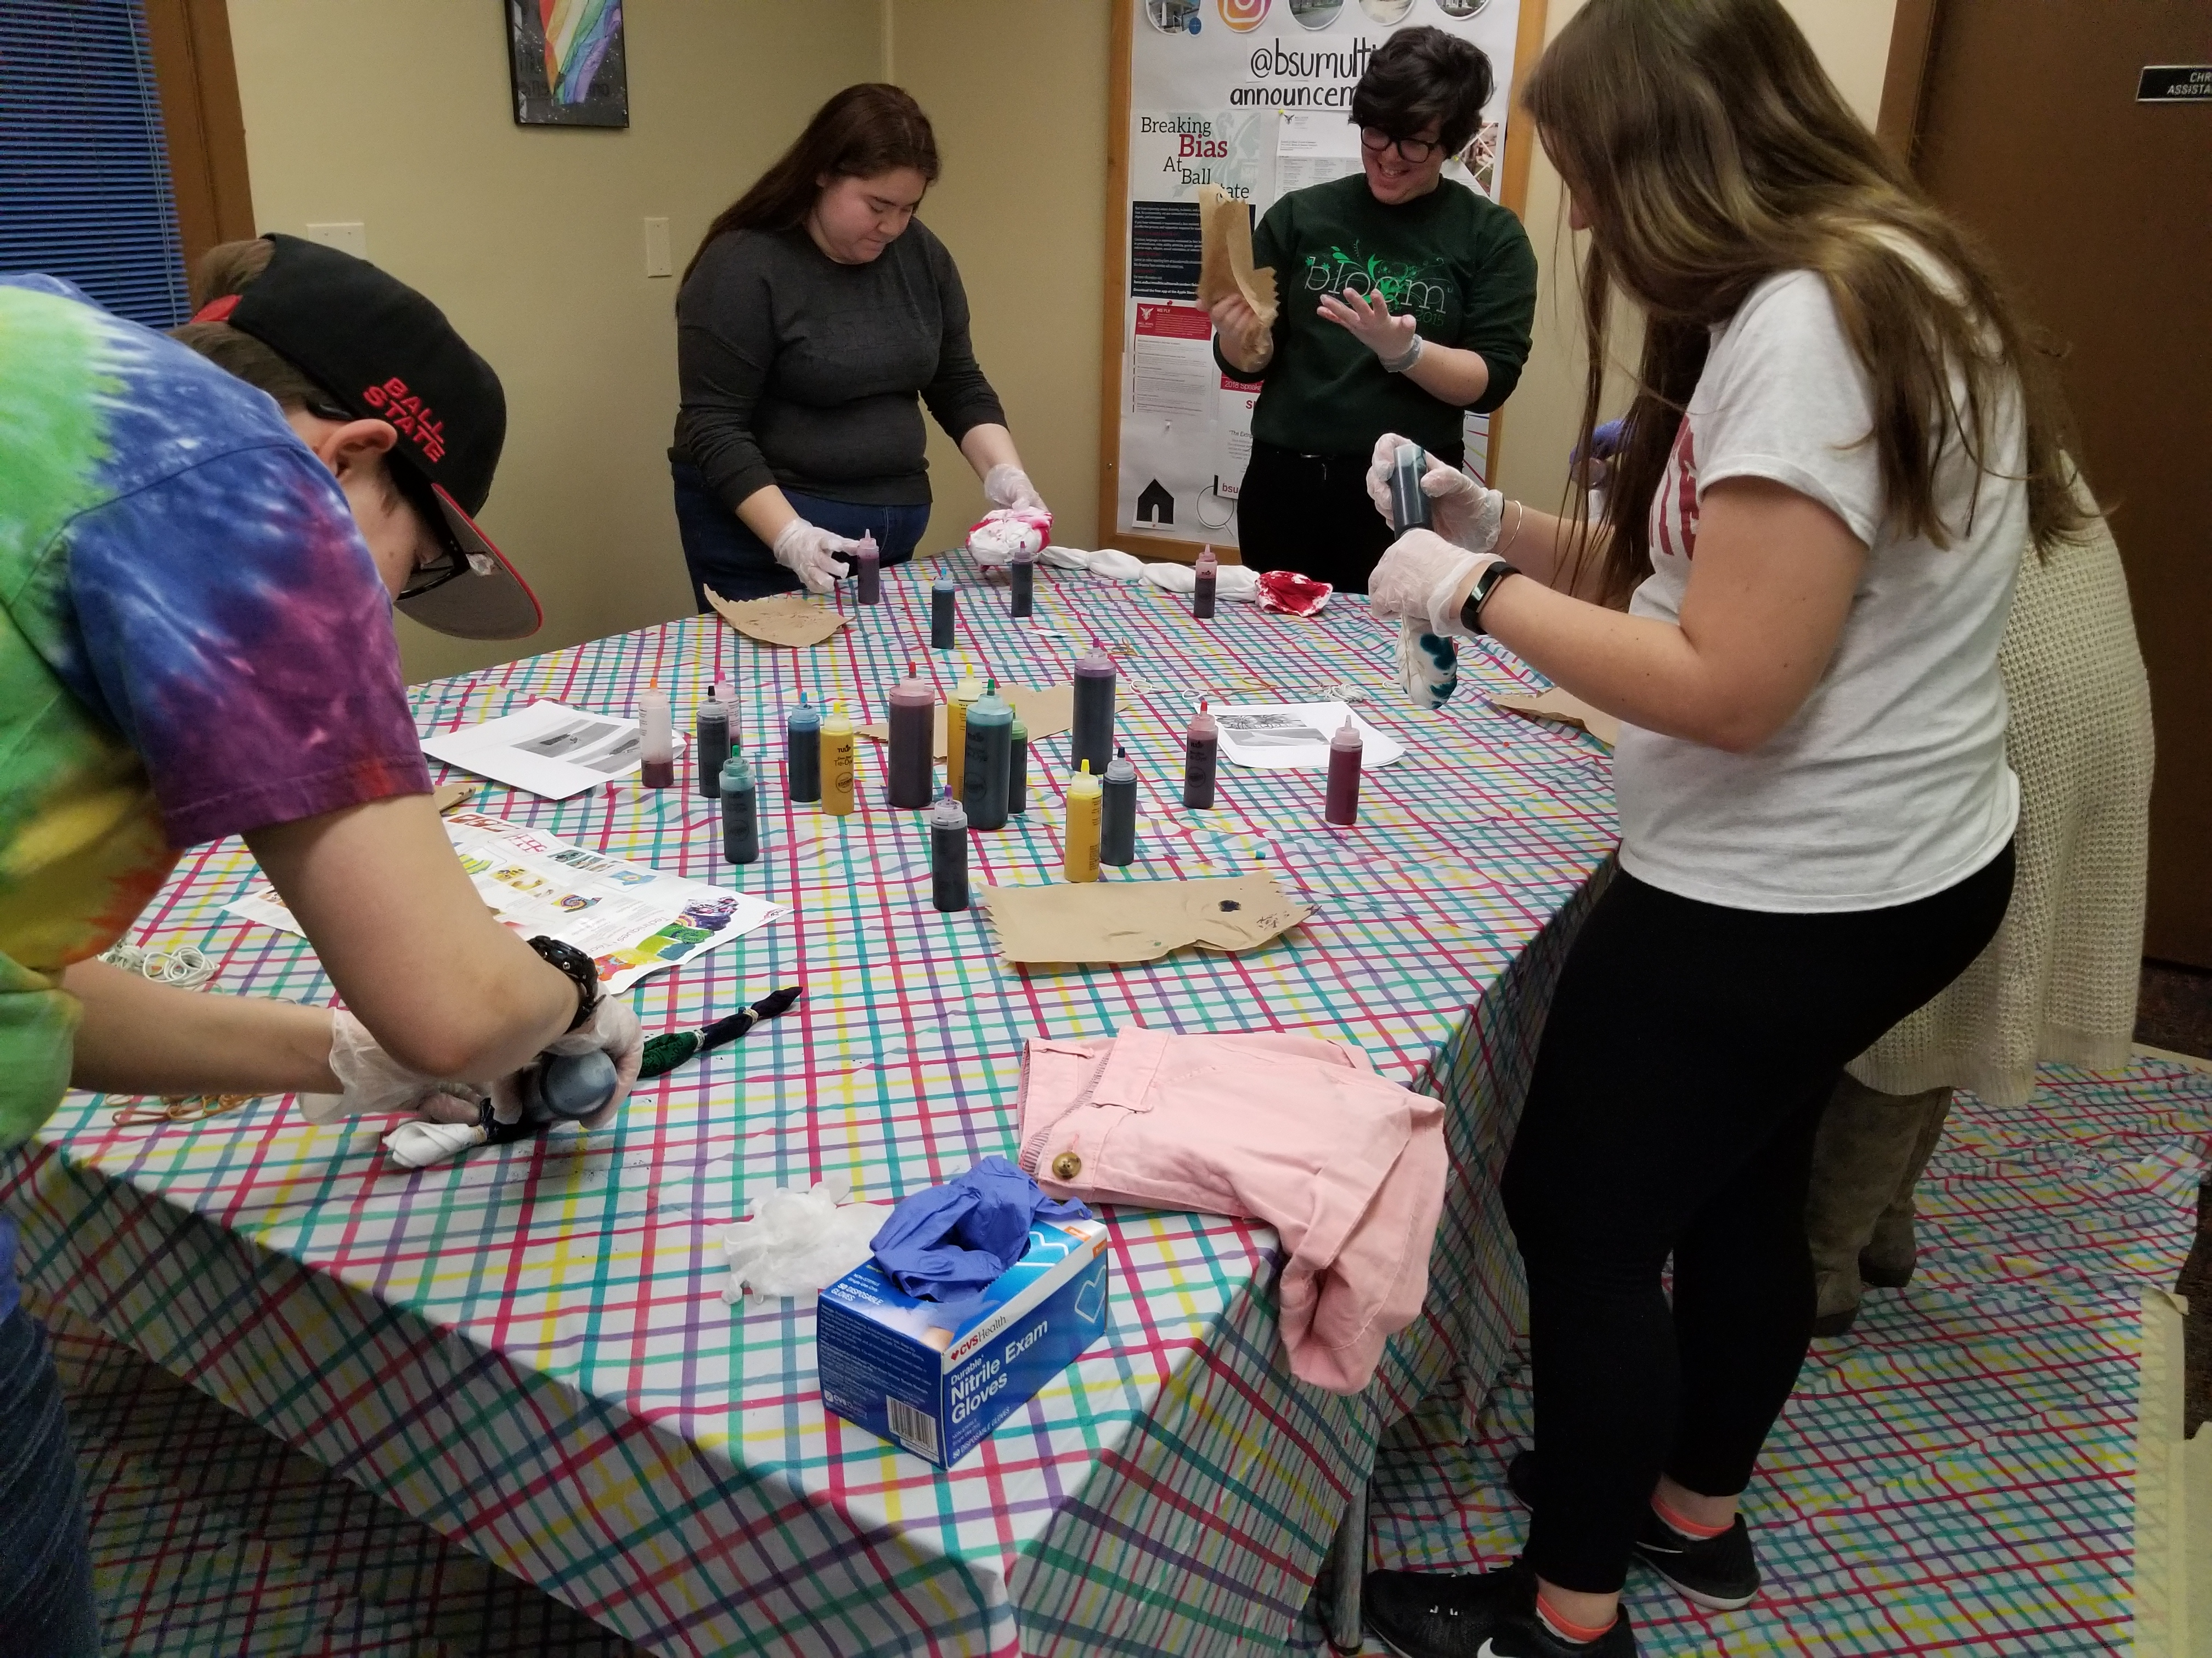
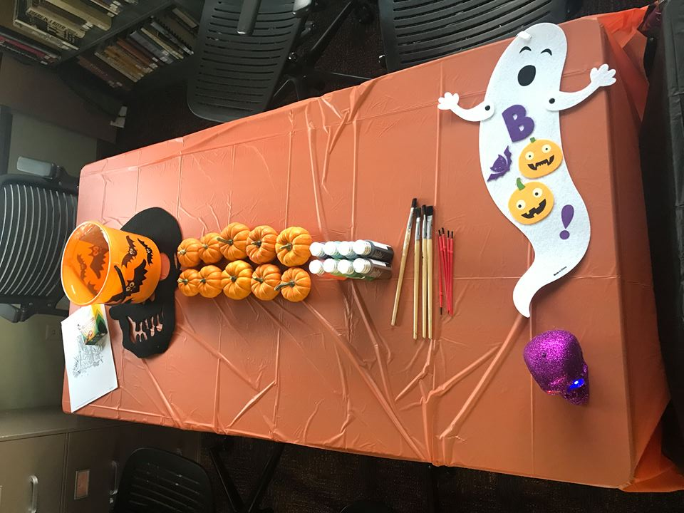
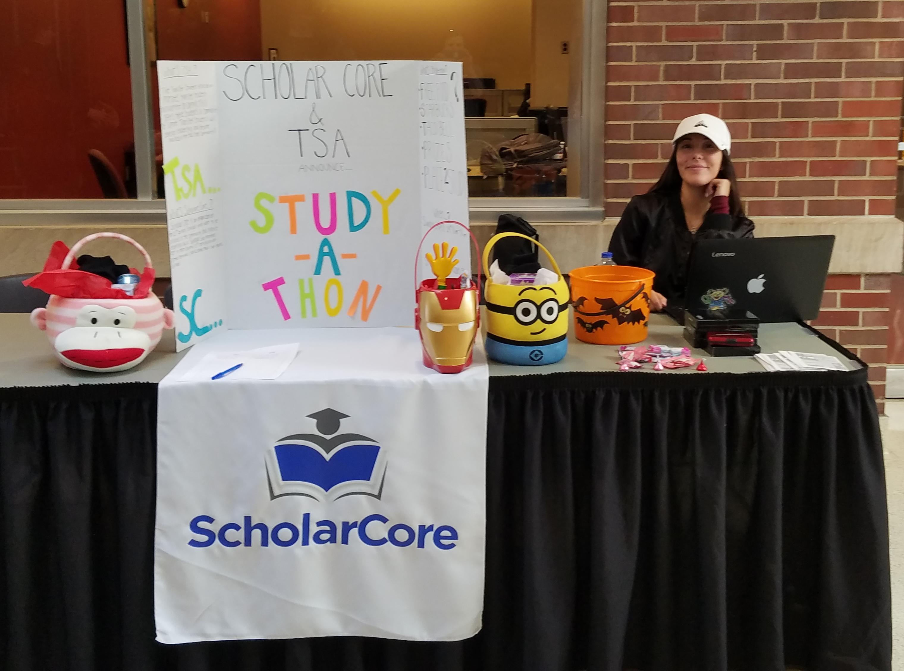
ScholarCore
ScholarCore hosts multiple events throughout the school year.
Previous events have included :
Bowling Night
Study-A-Thon
Food Drive
Crafting Event
FAFSA/Scholarship Workshop
End of Year Celebration
Volunteer/Community Service

Slide 31
ScholarCore
How can you get involved?
Well I’m glad you asked. ☺
Look for us on Benny Link & search ScholarCore
2) We will email you about meetings when we resume in September

Slide 32

Questions?

Slide 33


Thank you!

