Slide 1









Purchasing Services
10.30.2025

Slide 2




Purchasing Services
B450 Move Request Training

Slide 3

Purchasing Services Summary
Purchasing services is an area of Business and Auxiliary services.
Purchasing services offers several services to the campus community that are listed below, completely free to your department.
  MOVING AND EXCESS
  RECYCLING
  INVENTORY CONTROL
  GOVDEALS ONLINE AUCTION
  CENTRAL MAIL
  CENTRAL RECEIVING
  CENTRAL STORES
  EXCESS CATALOG AND BACK-TO-CAMPUS ITEMS
  LONG TERM STORAGE

Slide 4
What is a B450 Move Request
A B450 move request is a document used to request a move with Purchasing services.
  The B450 move request form is located on the JAGGAER Home page.
  Listed under Moving, Storage and Inventory forms .
  A B450 is used to schedule the material handlers job task daily.
  A B450 is used to track the life cycle of item(s) purchased by the university.
    Includes;
      Capital Assets
      Non-capital assets (also called items/equipment)
      Electronics.
    The University Controller’s Office uses this form to track Capital Assets.
      Capital Assets are item(s) purchased with BSU funds that cost $5,000 or more.
      To track the proper removal and disposal of items and equipment purchased with the
University funds.

Slide 5
B450 Move Request - Categories
Recycled Items - Request for us to pick up recycled items such as batteries, lamps, toner, etc.
Excess - To remove item(s) from the department permanently.
Inter-Departmental Move - Move item(s) from room-to-room in same department.
Departmental Move - Department moving from one location to another on campus. It must be schedule With Assistant Director of Purchasing Services.
Loaned - Temporary use between departments.
Long Term Storage Item - All long-term storage request must go through the Assistant Director of Purchasing Services for approval.
Stolen/Lost - If equipment is lost or stolen. (include the BSU tag number, Serial Number, and Police report if stolen.
Traded- Purchased item and trading in old item (include the BSU tag number, Serial Number, and PO number for new item(s).
Transferred - Item(s) moved from one department to another or one location to another location (Building and Room.)

Slide 6
B450 Move Request- Categories Definitions
Excess Recycling/Disposal
Excess is the item(s) that your department no longer need.
  Item(s) can be reused by campus.
Item(s) purchased with BSU funds, must go on a B450 request form.
Items purchased with BSU funds cannot be taken home, donated or given away for personal use.
Recycling means that the item(s) can no longer be used.
Such as Broken equipment, electronics, and
furniture.
Recycling can also be used for bad batteries, bad and/or broken lamps, and plastic wrap.
All items must be listed on a B450 move
request.

Slide 7
B450 Move Request- Categories Definitions
Inter-Department Move
Request to move item(s) within the same location.
Such As:
Within The Same Office.
Same Room
Same Department.
Between rooms within a department.
Departmental Move
Moving your office/location to another space. Such as:
Moving from one building to another building.
  Must be scheduled with the Assistant Director of Purchasing Services.
  The Assistant Director of Purchasing Services and/or the Material Handler Supervisor will reach out to the contact person listed on the B450, to schedule the departmental move.

Slide 8
B450 Move Request- Categories Definitions
Loaned
Loaned is a request to borrow an item(s) from another department.
Example:
  This could be used for borrowing stanchions, linen, signage, etc. for events.
Traded
A department has and/or will be trading in old and/or damaged equipment or furniture.
The B450 Move form MUST have the following;
  BSU Tag number
  Serial number of old and/or damage item.
In the additional note field, please add the
Original PO number if you have it.
Attach the new PO information to your internal notes.
To start the trade in process, you must contact a Purchasing agent to ensure you have the proper trade value established.

Slide 9
B450 Move Request- Categories Definitions
Long-Term Storage
Stolen/Lost
A B450 move request is required if an item(s) is lost and/or stolen.
Long term storage is an option for departments to store furniture and/or equipment that they want to keep and will use within a year.
Long term storage is approved depending on availability of space.
Departments are only allowed to store item(s) up to a year and/or until
the remodeling of their location is complete.
Once you put in a long term storage request, it must be reviewed and approved by the Assistant Director of Purchasing Services.
  If approved, an additional form must be filled out, that will be sent to
you directly.
Long term storage is not a space to put your equipment and/or furniture you do not want to get rid of due the possibility of using it at a later date.
We have a warehouse in Muncie that is located at 3100 E. Memorial.
You must provide the following;
BSU inventory number
Serial number
The department in which the item belonged too.
If an item has been stolen, please contact the University police and fill out a police report.
  A copy of the police report msut be attached to the B450 move request
We will contact you throughout the year as a reminder of your items.
After a year, we ask that you come out and review your items.
Please contact the Assistant Director of Purchasing @ 285-1803 for a Long Term Storage Form.

Slide 10
B450 Move Request - Required Information
Before you start your B450 move request, you will need to gather information to help fill out your request.
  BSU Tag Number. see the next slide for pictures of a inventory tag.
    BSU inventory tag numbers are placed on item(s) that are $5,000 or move.
    Electronics may have a BSU inventory tag.
    Older furniture may have a BSU inventory tag on it. (e.g. file cabinets, bookcases, etc.)
  Serial Number of the item(s).
    If the item(s) have a serial number it must be listed on the B450.
  Description and quantity of items that are being placed on the B450 move request.
  Location of where the item(s) are located for pickup. ( e.g. RB-239)
  Location of where the item(s) are being moved to. ( e.g. TC-778)
Once you have gathered all this information, you are ready to starting filling out your B450 Move request.

Slide 11
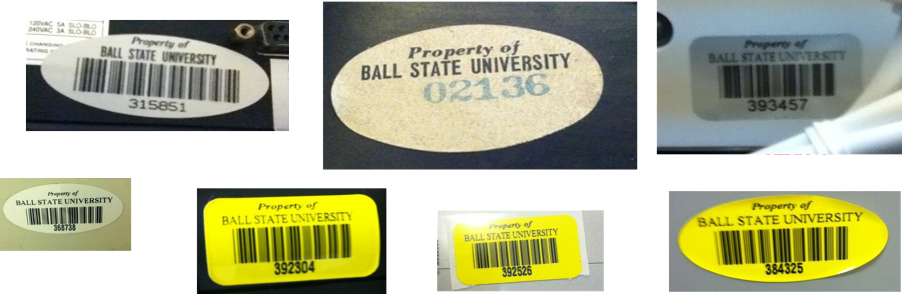
B450 Move Request – BSU Inventory Tags
Examples of BSU Inventory Tags you will find on your item(s).

Slide 12
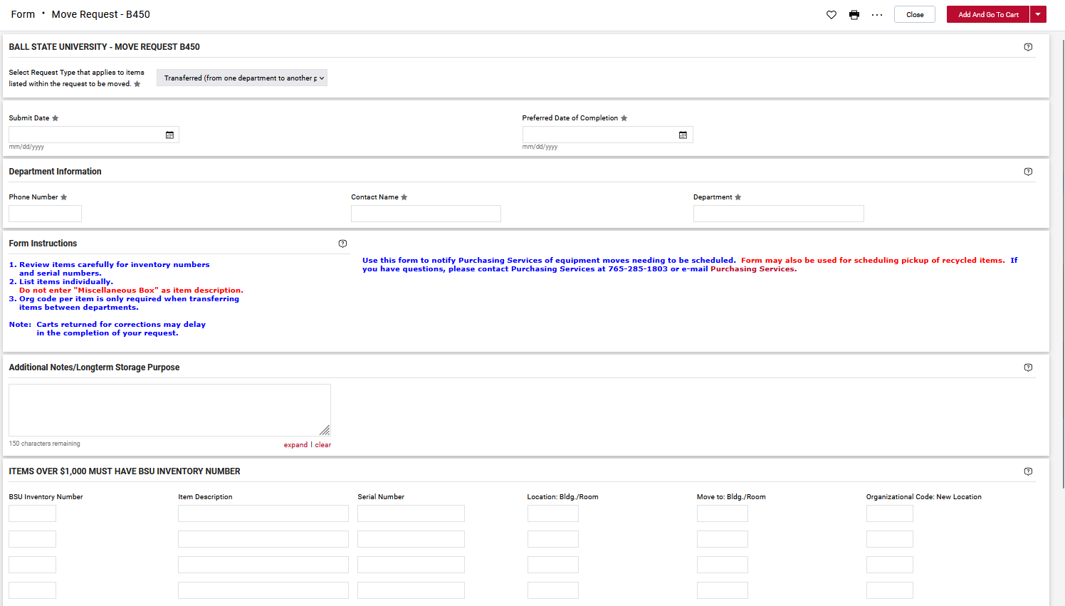
How To Fill Out Your B450 Move Request
Select from the drop down.
Submit Date- is the day you are filling out form
Preferred Date of Complete
  The latest date you would like this request to happen
Phone Number
Contact Name
Department- department requesting the move
Note
  Add anything you want us to know about this move.
  The more information you give, the easier it is to get the job done.

Slide 13
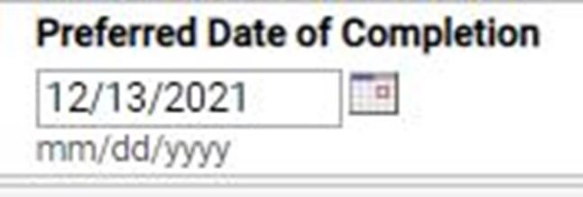
B450 Move Request – Preferred Date of Completion
The preferred date of completion is the date you would like service.
If you do not have a preferred date of completion, please put this date out a few weeks from the date of submission.
  We will work on getting your request schedule ASAP.
The preferred date of completion field helps us schedule your request.
  This is a preferred date ONLY.
  We cannot guarantee that your request will be completed by this date, but will try to have it completed before or on this date.
Please make sure to leave information in the additional notes, that you deem important to making your move
a smoother process.

Slide 14
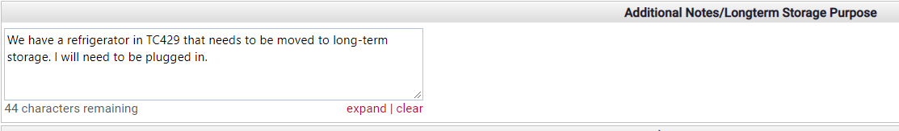
B450 Move Request - Additional Notes/Long Storage Purpose Field
The field to the right is for additional information.
Such as:
  Certain dates and times you are available.
  Who to contact if you are unavailable.
  This item does not need to be moved by Purchasing Services because it was already moved.
You have 150 characters to list in this field. If you need additional space, there are different options available.
  Add the information to the internal notes at checkout (On JAGGAER).
  Add the information in the comments after you have completed your B450 move request (On JAGGAER).
  Email additional information to the Assistant Director of Purchasing Services.
    The Assistant Director of Purchasing Services, can add information for you once your request.

Slide 15




















B450 Move Request – Item Description field
The item description field is a required field. (Additional details provided on the next slide)
List the item(s) with the best description.
  You must add the quantity of items that you are requesting to move if there is more than one item.
    As an example: 2 steel case metal desks, 4 drawer filing cabinets, box of magazines, 5 boxes of hanging folders.
You MUST list each item on the item description field.
  You cannot list an item(s) as a box of miscellaneous.
    If you do list as miscellaneous, your B450 move request will be rejected and sent back to you for additional information.
    Every item(s) purchased with BSU funds must be listed on the B450 move request.
The additional notes/long term storage purpose box, is not to list the items you want moved.
  This field is for supporting information; e.g. specific times, contact names & numbers.
  If you list your item(s) in this field, we will reject your B450 move request.

Slide 16
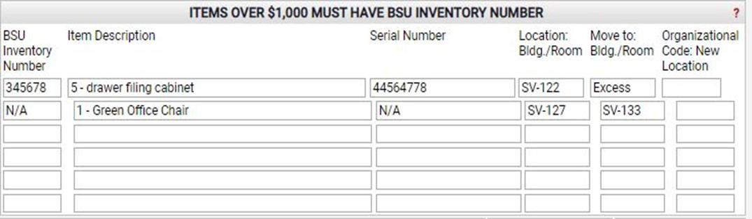
How To Fill Out Your B450 Move Request
BSU Inventory Number
  Required to move an capital asset
Description of item you are requesting to move
Serial Number
  If present
Location
  The current item is located
  Must list Building name and room number
Move To
  Where is the item going
  Must list building name and room number
Operational Code of New Location- You do
not fill out.

Slide 17




































How to Start the Checkout Process of Your B450 Move Request
Click the Red Add and Go to Cart button.
  This will be located in the right top corner of your B450 Move Request form by the available actions drop down.
This will take you to your JAGGAER shopping
cart.

Slide 18
















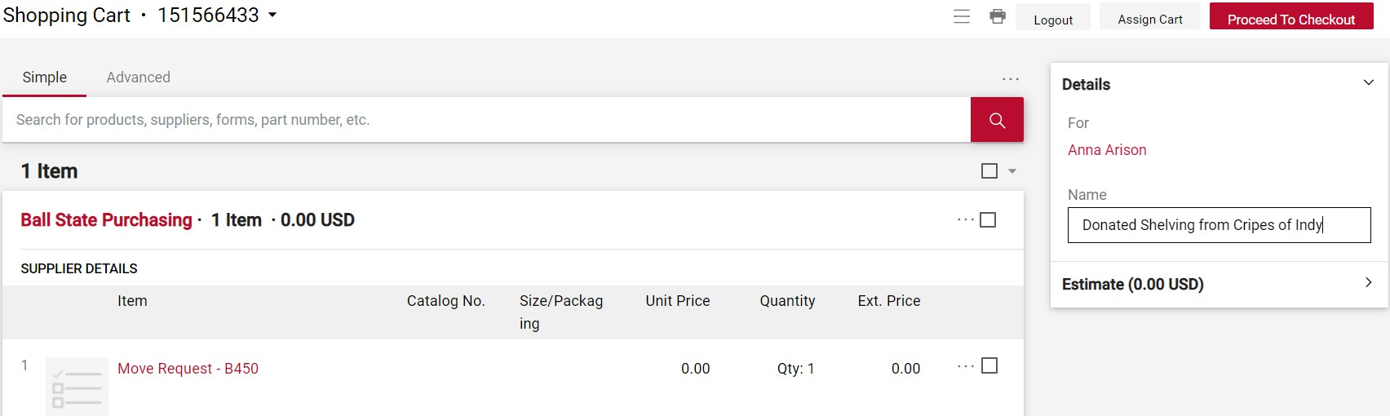
Checkout Your B450 Move Request
You can change your JAGGAER cart name on this screen.
Click on the Red Proceed to Checkout or Assign Cart.

Slide 19


















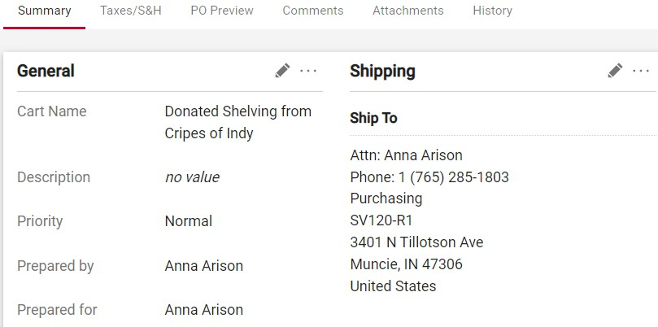
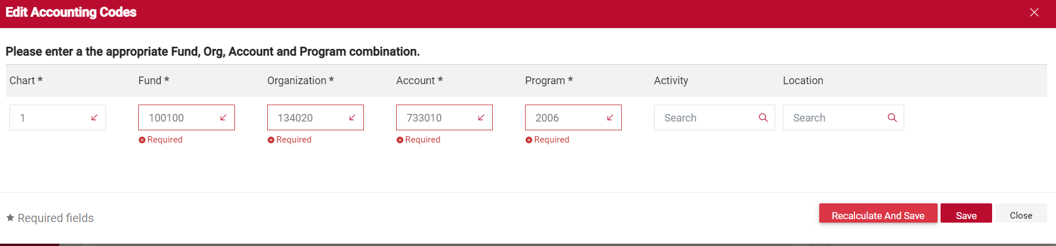
B450 Move Request – Checkout Process
Your cart should look similar to the picture to the right.
  Check the shipping information to the make
sure that it is correct.
You must add your accounting codes.
  This will be your departmental FOAPAL.
  B450 move request are a free services, but JAGGAER requires a accounting code/FOAPAL.
  Once the accounting codes/FOAPAL number is entered, you will click on the red Save tab and/or the recalculate and save tab.

Slide 20






















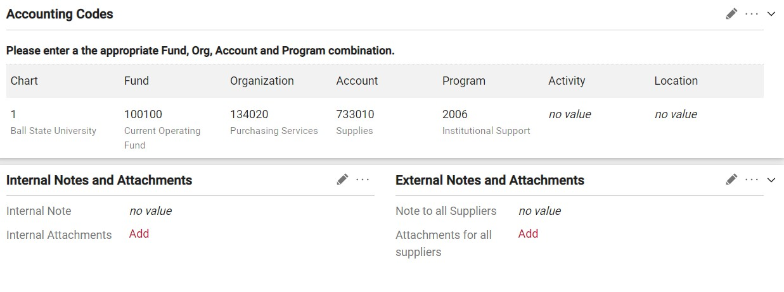


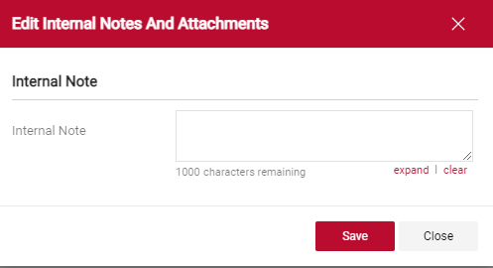
How to Add Internal Notes and Attachments
Internal Notes and Attachment option will be under the
Accounting Codes Field.
  The internal notes and attachments is where you add any additional information you need to us to know.
Click on the in the right side of the Internal Notes and Attachments.
  We circled the in the top picture to make it easier to located for this presentation.
When you click on the , a box will pop up like the picture to your right.
You have 1000 characters to add to this box.
Leave any additional comments and/or notes you
want us to know before submitting.
Once you are finished with this box, click on the red save tab.

Slide 21



















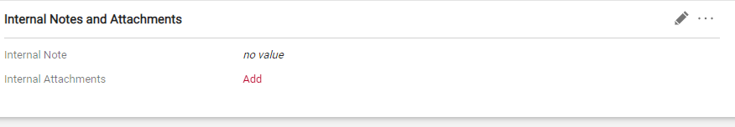

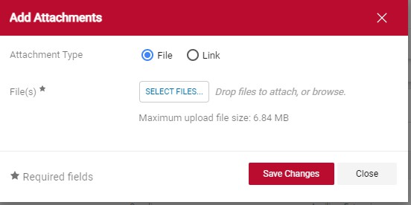
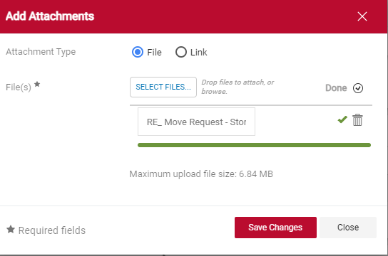
How to Add Internal Notes and Attachments
To add an attachment to your B450 Move Request, you must
click on the red add tab.
A box will pop up like the second picture to your right.
  You will click on select files.
  If you attachment has been accepted, you will see a green line and a green with a trash can beside it.
If you attached the wrong attachment or
want to remove the attachment from the requisition, click the trash can to delete the attachment.
You must click on the red Save Changes, for your attachments to save to the requisition.

Slide 22



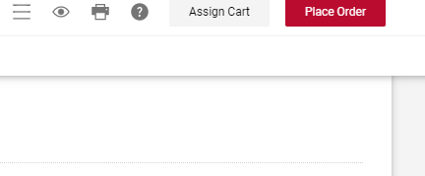
Complete Your B450 Move Request – Checkout
Once you filled in your accounting codes, added internal notes and attachments.
Click the red place order to submit your cart to the next approver in your department.
or
Click the grey assign cart tab to assign to another person.

Slide 23












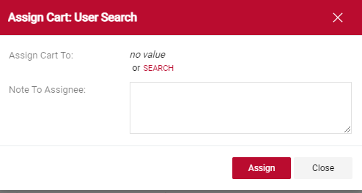
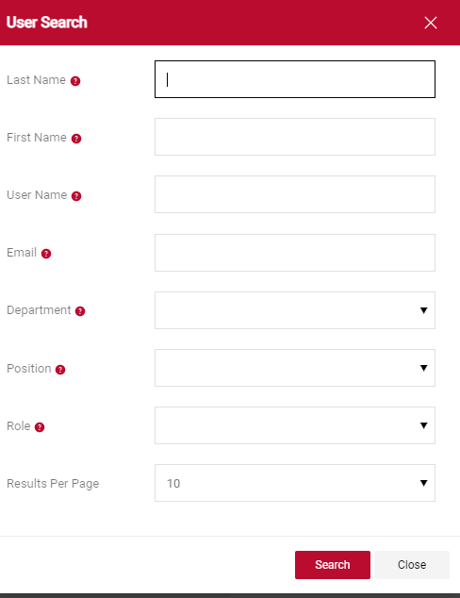
How to Assign a Cart
If you are assigning your cart to another employee.
Click the word Search in red.
A new box will open for you to search for the person, you are assigning the cart.
Type in the last name and first name of the person you are searching and click the Red Search tab.

Slide 24












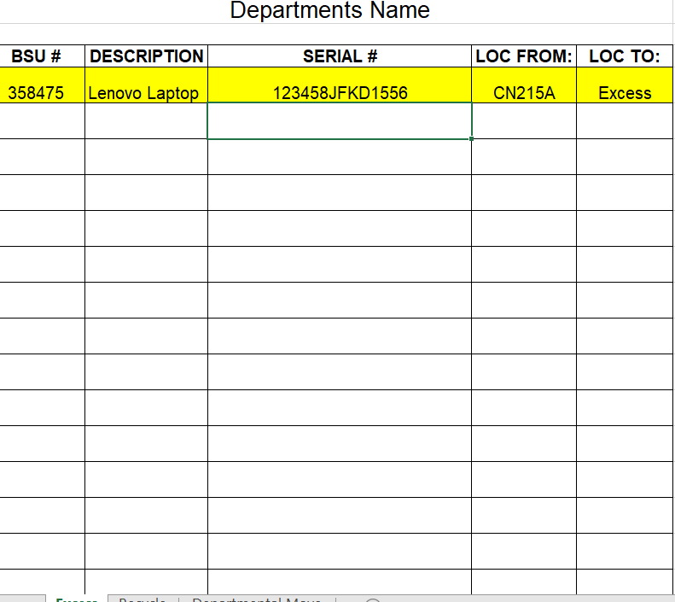
What if I have more to add than six lines?
If you need to add more than six items to your B450 move request you can add an excel spreadsheet as an attachment.
The Spreadsheet must have the same information that the B450 move request does.
  To the right is an example of what your spreadsheet must look like.
Add this attachment to the internal notes and attachment.

Slide 25















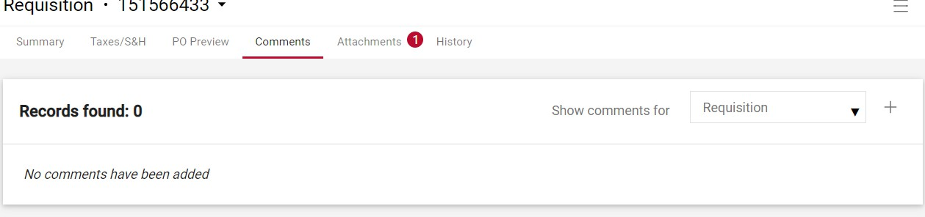
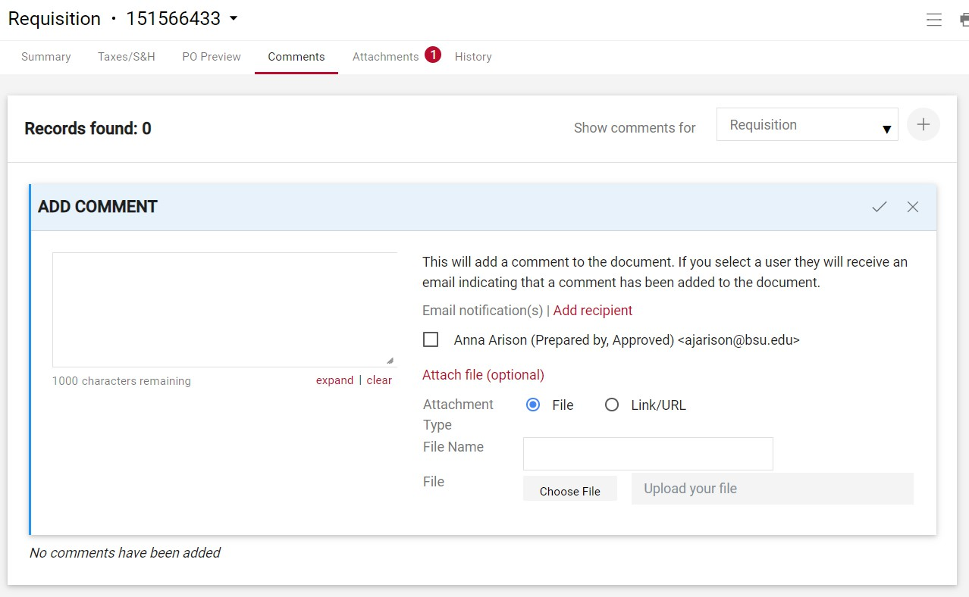
How to Add Comments to a Requisition
You can look up your requisition by the number in the search bar, which is located by your cart tab.
Once you have the requisition pulled up, you can attach your spreadsheet in the comment tab at the top of the requisition and/or the internal notes and attachment.
If you enter the attachment in the comments.
  Click comments.
  Click the + sign to the right of the page.
    We circled for the presentation.
Add comment box will appear with names from your department.
  To add someone else you will need to click the
Red Add Recipient.
  A User Search screen will come up for you to type in the name you are looking for.

Slide 26















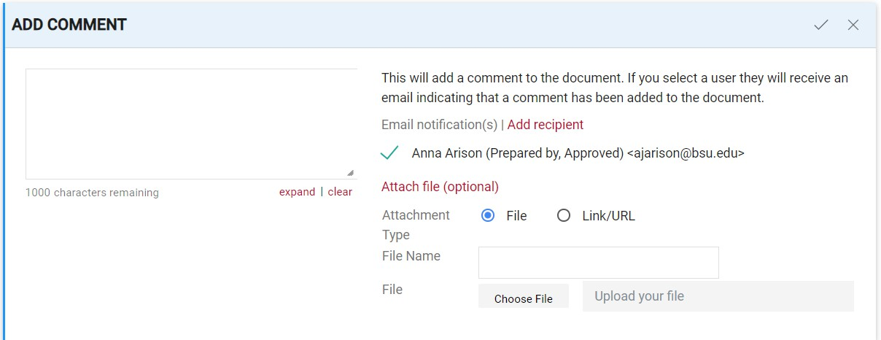

How to Add Comments to a Requisition
Once you have found and selected the name, click the +
sign on the right side of the tab.
The name will appear with a green check beside it.
Next go down to Attach file (optional)
Fill in the File Name
Click on the Choose File tab in grey.
Click the in the top right corner to send your comments to the person with the their name.
Or
Click the X in the top right corner delete the comment and attachment.

Slide 27
Who to Contact for Questions and Concerns
Interim Senior Director of Business Services for Purchasing, Printing, and Contracts and Director of Purchasing
765-285-1532
Assistant Director of Purchasing Services
765-285-1803
Purchasing Services Material Handler Supervisor
765-285-6300
Central Stores Coordinator
765-285-1802

