Slide 1
PURCHASING CARD audits & bdm 2025
Presented by the Office of Accounts Payable

Slide 2
HIGHLIGHTS OF Ball State University Procurement Card (Pcard card) Policy CHANGES
International charges are prohibited
All shipments must go to an official University address
The business purpose must be documented for all purchases
Recurring charges are prohibited if credit card number is stored with vendor
Office supplies are prohibited except through JAGGAER’s Showcase Supplier, Staples
Amazon purchases are prohibited except through JAGGAER’s Showcase Supplier for Amazon
Electronic & Tech purchases are limited and should be made in accordance with the Ball State University IT Purchase Policy
Ball State University Point Of Sale system purchases are prohibited (Dining, Parking, Tech Store)
Rolling 12 month violation point accumulation instead of fiscal year
Card revoked/suspended if any violation remains unresolved after 3 months
If 30 violation points are accumulated in a rolling 12 month period, remedial training will be required by Purchasing Services
Receipts not Uploaded and Receipts Uploaded after the 20th have been combined into one violation; FAILURE TO UPLOAD DOCUMENTATION BY THE 20TH OF THE FOLLOWING MONTH
Most cards have a $4K single transaction limit and a $15K monthly credit limit
Purchasing Card Audits & BDM 2025
Office of Accounts Payable

Slide 3
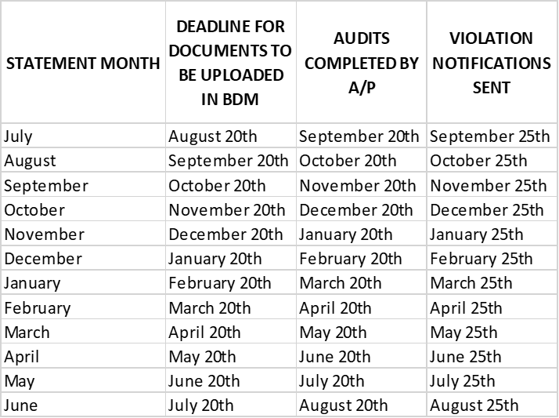
PURCHASING CARD TIMELINE
Purchasing Card Audits & BDM 2025
Office of Accounts Payable

Slide 4
BDM PURCHASING CARD ACCESS REQUEST PROCEDURES
The instructions below can be found on the Purchasing Services website
Or you can go directly to Service Now bsu.service-now.com/helpdesk
  Request Services
  Security Access
  BDM
  Complete the form. When asked to select the application you would like access to, choose both BSU-F-STATEMENTS and BSU-F-PCARDRCPTS
  Click Submit
An e-mail should be sent when the request is made and another when the request is complete
Purchasing Card Audits & BDM 2025
Office of Accounts Payable

Slide 5
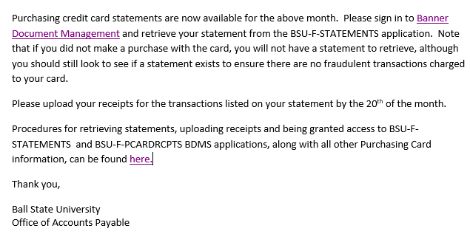
MONTHLY EMAIL TO CARDHOLDERS AND AUDITORS (1 of 2)
Purchasing Card Audits & BDM 2025
Office of Accounts Payable

Slide 6
MONTHLY EMAIL TO CARDHOLDERS AND AUDITORS (2 of 2)
Sent on the first business day of each month
Please review the statement each month when this notification is received, even though purchases may not have been made, to verify there aren’t any fraudulent charges on the card
Cardholders are automatically added to and removed from this notification based on their PCard status
Departmental auditors are removed based on an HR report for Employees Leaving BSU
New departmental auditors that need added, or auditors that have changed positions and no longer need the notification, should email ap@bsu.edu with those requests
Purchasing Card Audits & BDM 2025
Office of Accounts Payable

Slide 7
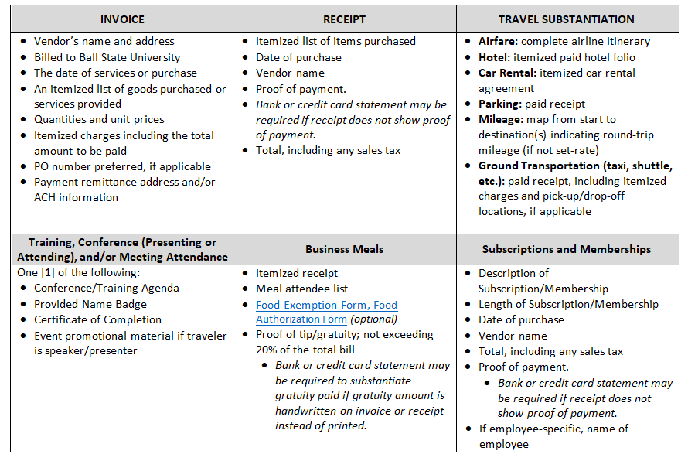
DOCUMENTATION REQUIREMENTS
Purchasing Card Audits & BDM 2025
Office of Accounts Payable

Slide 8
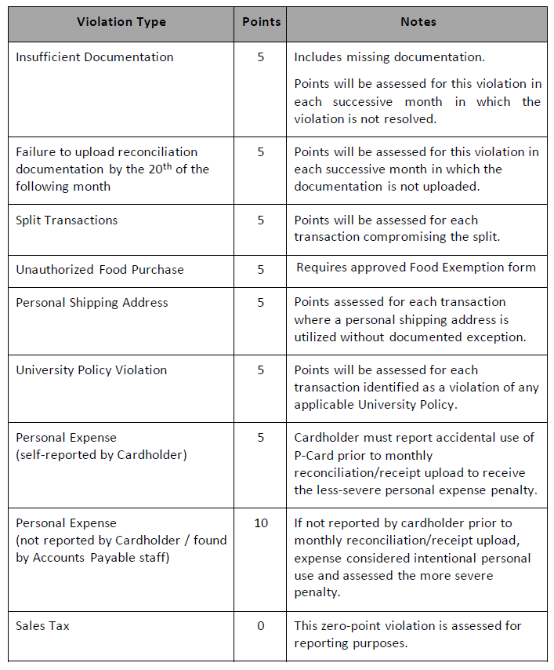
Purchasing Card Audits & BDM 2025
Office of Accounts Payable

Slide 9
PURCHASING CARD VIOLATIONS (1 OF 2)
INSUFFICIENT DOCUMENTATION
No receipt uploaded for a specific transaction
Receipt that was uploaded doesn’t meet documentation requirements
FAILURE TO UPLOAD DOCUMENTATION BY THE 20TH OF THE FOLLOWING MONTH
No receipts were uploaded in BDM for a specific month
Receipts were not uploaded by the 20th of the following month
SPLIT TRANSACTION (5 points per transaction)
The transaction is split into two smaller transactions to circumvent the single transaction limit
Most cards have a $4K single transaction limit and a $15K monthly limit
UNAUTHORIZED FOOD PURCHASE
Food was purchased without an approved Food Exemption form
SALES TAX (notification only)
If sales tax was charged on any transaction, you will receive one notification
It is up to the department whether to work with the vendor to have the tax credited or deposit the funds using a Cash Receipts Voucher/CashNet at Student Financial Services
BSU is still exempt from paying sales tax
Failure to have the sales tax credited or reimbursed will negatively impact your department’s budget
PERSONAL SHIPPING ADDRESS
Must be shipped to an official University address
UNIVERSITY POLICY VIOLATION
Prohibited purchase per Purchasing Services Credit Card Policy (available on their website)
PERSONAL EXPENSE (self-reported by Cardholder)
Cardholder must report accidental use of P-Card prior to monthly reconciliation/receipt upload to receive the less-severe personal expense penalty
PERSONAL EXPENSE (not reported by Cardholder; found during audit)
If not reported by cardholder prior to monthly reconciliation/receipt upload, expense considered intentional personal use and assessed the more severe penalty
Purchasing Card Audits & BDM 2025
Office of Accounts Payable

Slide 10
PURCHASING CARD VIOLATIONS (2 OF 2)
Points will accumulate on a rolling 12 month period
Five additional points will be assessed for the INSUFFICIENT DOCUMENTATION and FAILURE TO UPLOAD DOCUMENTATION BY THE 20TH OF THE FOLLOWING MONTH violations for each successive month in which the violation is not resolved
When a violation is resolved by the cardholder the points assessed are not removed, they are resolved
If a PCard accumulates 30 violation points within a rolling 12 month period, remedial training will be required by Purchasing Services
Cards will be revoked, or suspended for a period of six months, if:
A card accumulates 50 or more points within a rolling 12 month period
A violation remains unresolved after 3 months
Based on frequency and gravity of violations, University leadership may impose additional consequences including disciplinary measures
Purchasing Card Audits & BDM 2025
Office of Accounts Payable

Slide 11
ALLOCATIONS
Each PCard is set up with a default FOAPAL in Smart Data Online
Purchasing Services may be able to set up additional FOAPALs on the PCard in SDOL
Contact Purchasing Services for allocation training/questions in SDOL
Allocations must be done during the same calendar month that the transaction occurred OR no later than the first two business days of the following month
PCard charges are uploaded in Banner to the departmental FOAPAL on the 3rd business day of the month. Any allocations done in SDOL beginning on the 3rd business day of the month will not be reflected in Banner and will require a JV to move the expense to the appropriate FOAPAL.
Purchasing Card Audits & BDM 2025
Office of Accounts Payable

Slide 12
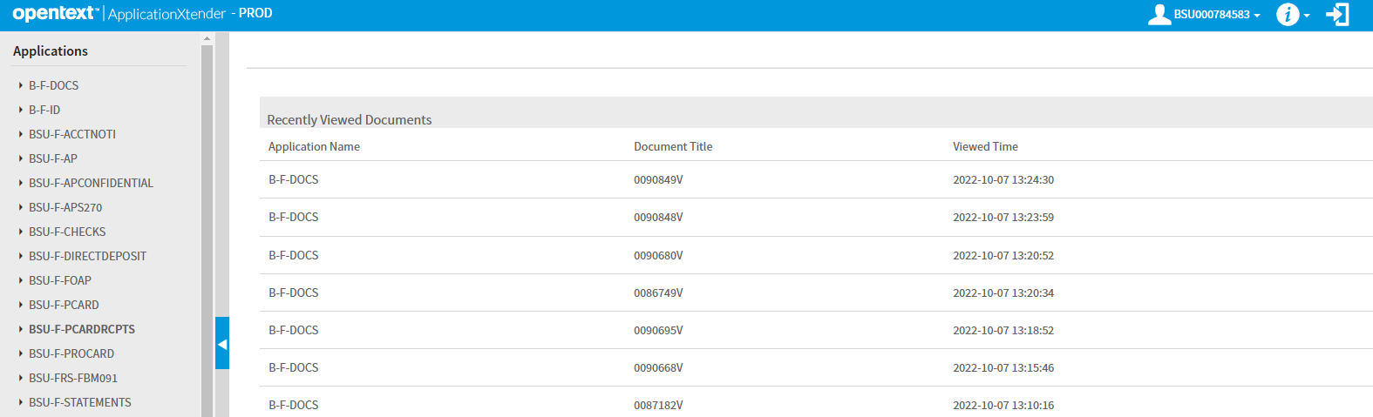
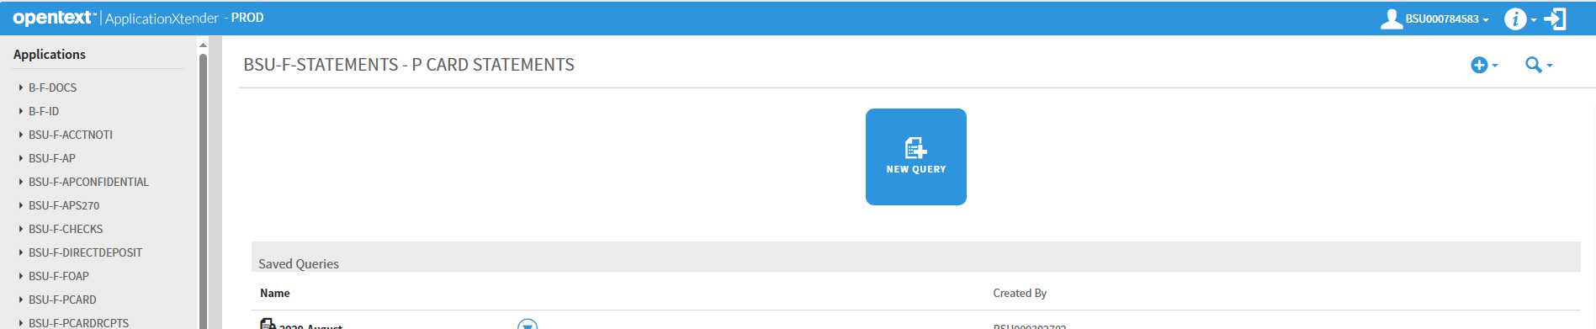
RETRIEVE STATEMENT IN BDM (1 of 2)
myballstate.bsu.edu
Banner Document Management (BDM)
Purchasing Card Audits & BDM 2025
Office of Accounts Payable

Slide 13
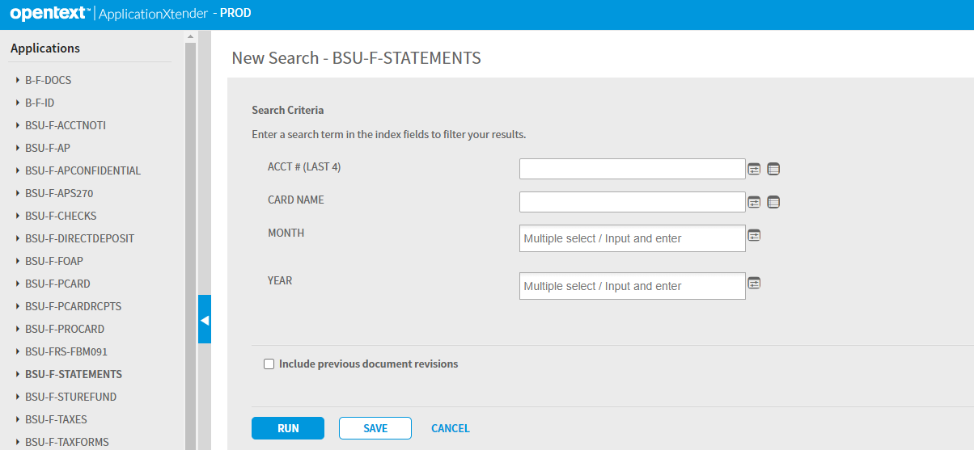
RETRIEVE STATEMENT IN BDM (2 OF 2)
Search by only ACCT # (LAST 4)
OR
Search by ACCT # (LAST 4), Month, Year
IF you search by CARD NAME, the name has to be entered exactly as it appears on the statement or this will cause a No Document Found error. To search by CARD NAME use the BDM wildcard *
Choose RUN
Purchasing Card Audits & BDM 2025
Office of Accounts Payable

Slide 14
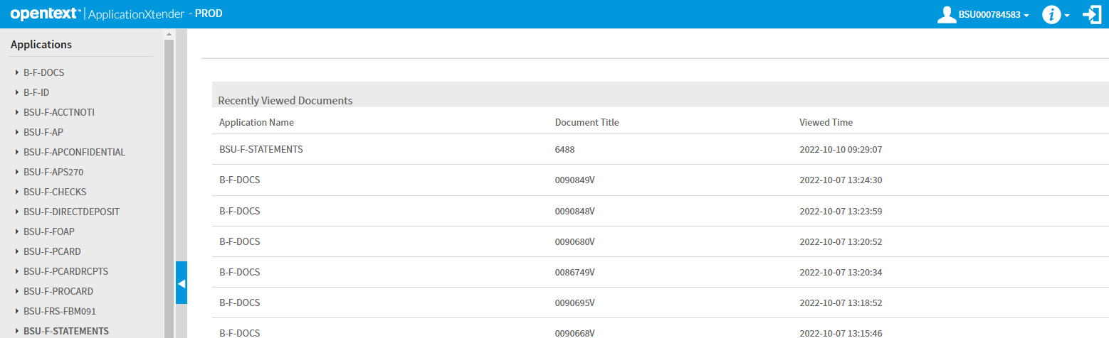
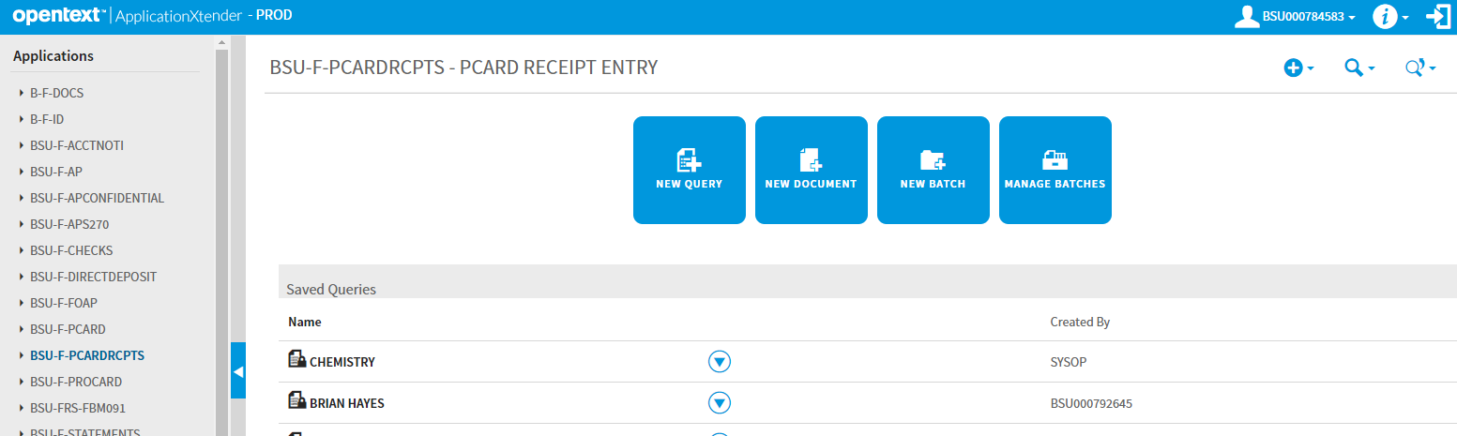
UPLOADING RECEIPTS IN BDM (1 OF 2)
Please upload receipts in the same order as they appear on the statement
Always select New Document, not New Batch
Purchasing Card Audits & BDM 2025
Office of Accounts Payable

Slide 15
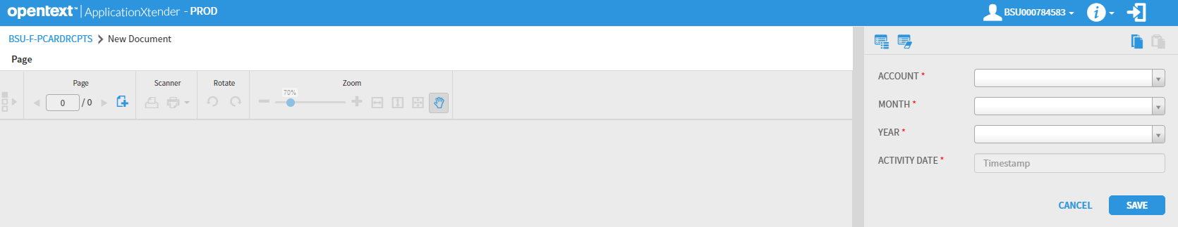
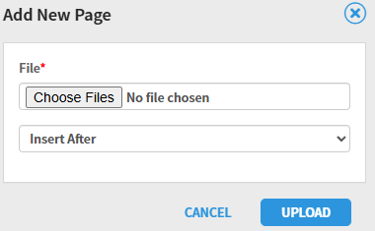
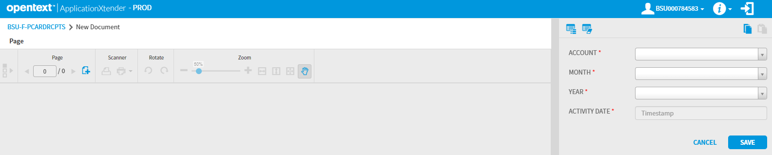
UPLOADING RECEIPTS IN BDM (2 OF 2)
Purchasing Card Audits & BDM 2025
Office of Accounts Payable

Slide 16
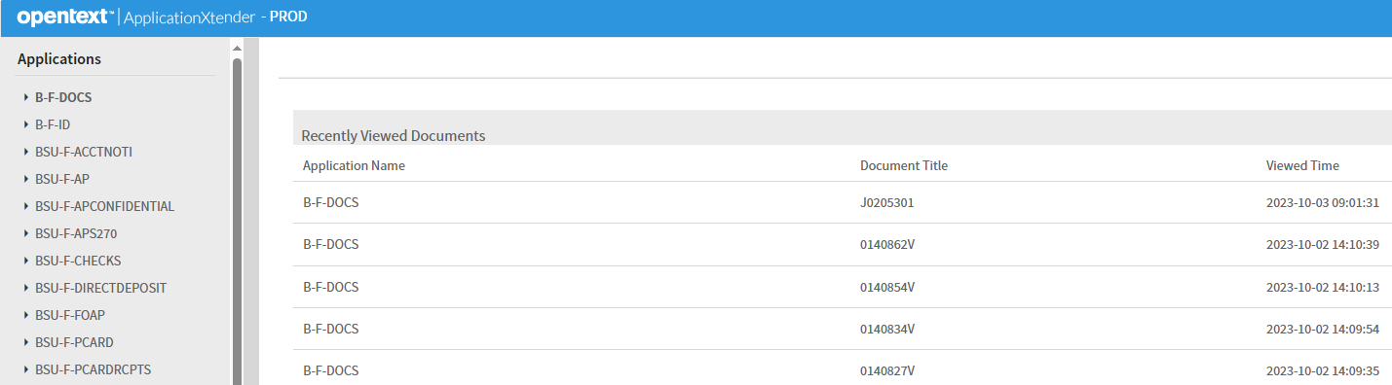
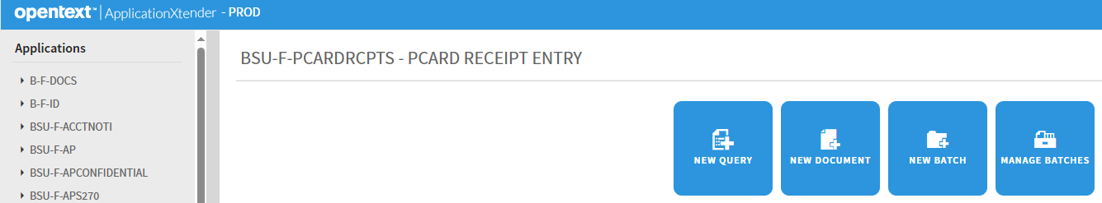
QUERY BSU-F-PCARDRCPTS BY CARD # ONLY (1 of 2)
Purchasing Card Audits & BDM 2025
Office of Accounts Payable

Slide 17
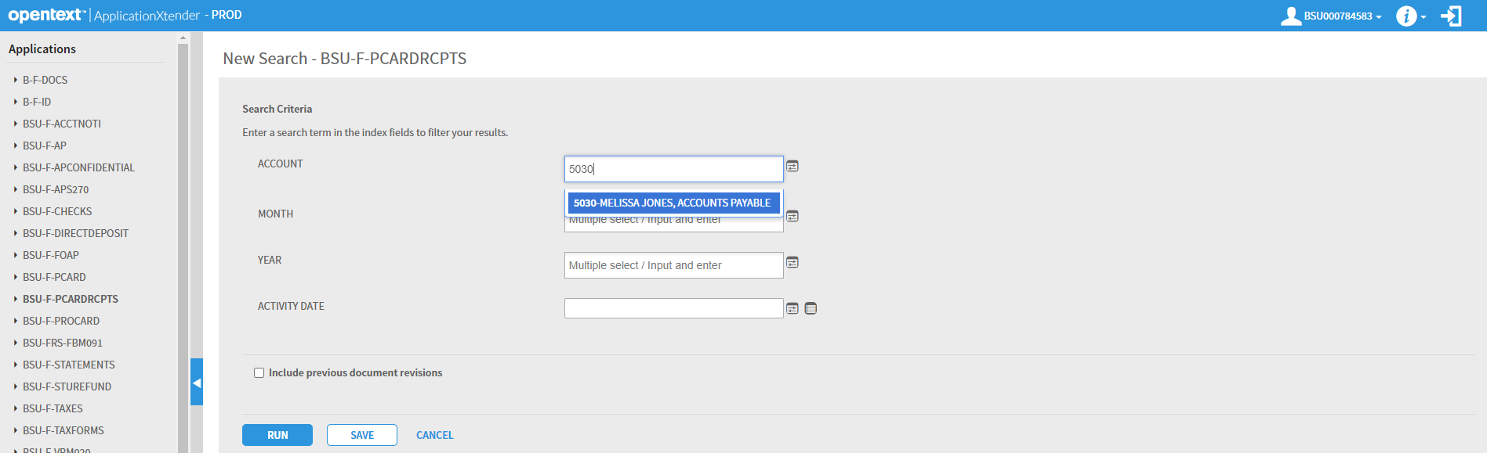
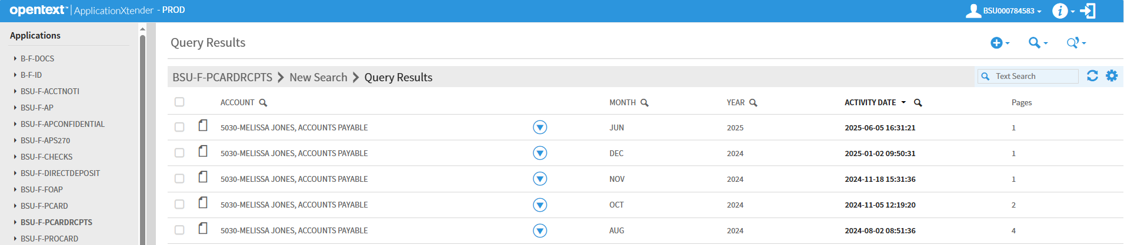
QUERY BSU-F-PCARDRCPTS BY CARD # ONLY (2 OF 2)
Purchasing Card Audits & BDM 2025
Office of Accounts Payable

Slide 18
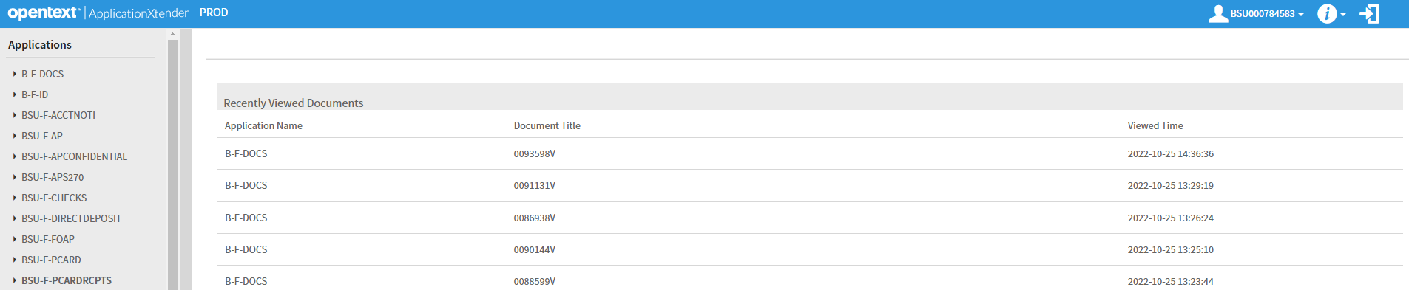
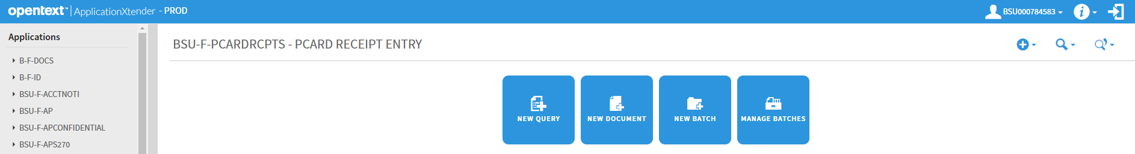
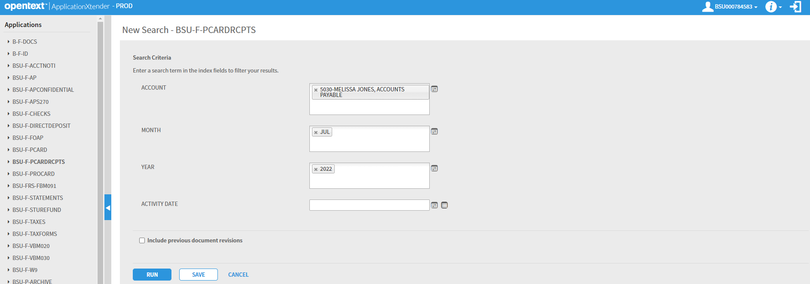
QUERY BSU-F-PCARDRCPTS BY CARD #, STMT MONTH, STMT YEAR
Purchasing Card Audits & BDM 2025
Office of Accounts Payable

Slide 19
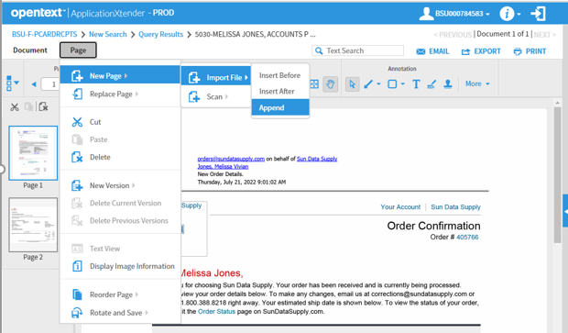
ADD NEW PAGE TO EXISTING DOCUMENT (1 of 2)
Query existing indexed document
Navigate to the appropriate page of the document
Page
New Page
Import File
Choose either Insert Before, Insert After or Append
Purchasing Card Audits & BDM 2025
Office of Accounts Payable

Slide 20
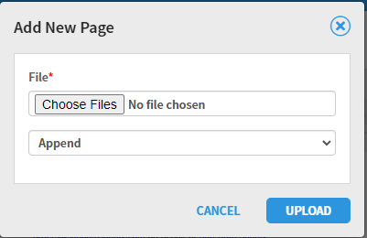
ADD NEW PAGE TO EXISTING DOCUMENT (2 OF 2)
This will open a dialog box so you are able to upload the add’l page
Choose Files
UPLOAD
Purchasing Card Audits & BDM 2025
Office of Accounts Payable

Slide 21
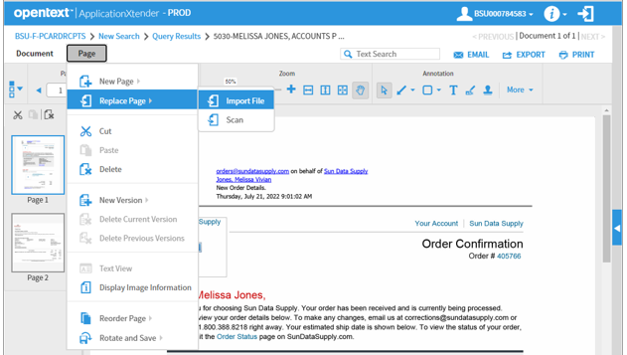
REPLACE PAGE IN EXISTING DOCUMENT (1 of 2)
Query existing indexed document
Navigate to the page you want to replace
Page
Replace Page
Import File
Purchasing Card Audits & BDM 2025
Office of Accounts Payable

Slide 22
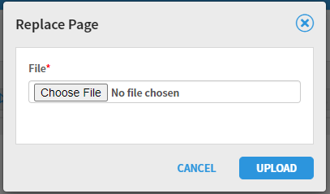
REPLACE PAGE IN EXISTING DOCUMENT (2 OF 2)
This will open a dialog box so you are able to upload the replacement page
Choose File
UPLOAD
Once a page has been replaced it is gone and you will not be able to retrieve it
Purchasing Card Audits & BDM 2025
Office of Accounts Payable

Slide 23
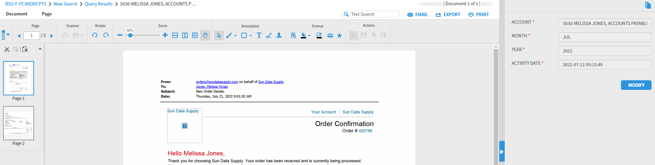
MODIFY INDEX OF EXISTING DOCUMENT
Query existing indexed document
If the indexing values are not visible click the arrow outlined in blue to open index panel
Choose MODIFY
Update value(s)
Save (after choosing MODIFY, SAVE will appear)
Purchasing Card Audits & BDM 2025
Office of Accounts Payable

Slide 24
REARRANGE PAGES USING THUMBNAILS
Select and hold the image you want to move
Drag and Drop- (If you are able to view both the current and target location of the image)
Drag the image to the desired position and release
Cut and Paste- (If you are not able to view both the current and target location of the image)
Select the image you want to move
Choose the scissor icon
Select the target page
Choose Paste
Purchasing Card Audits & BDM 2025
Office of Accounts Payable

Slide 25
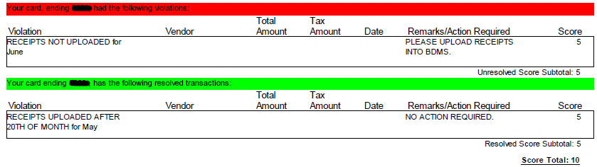
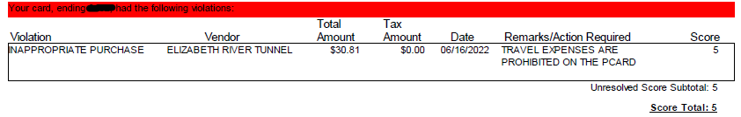
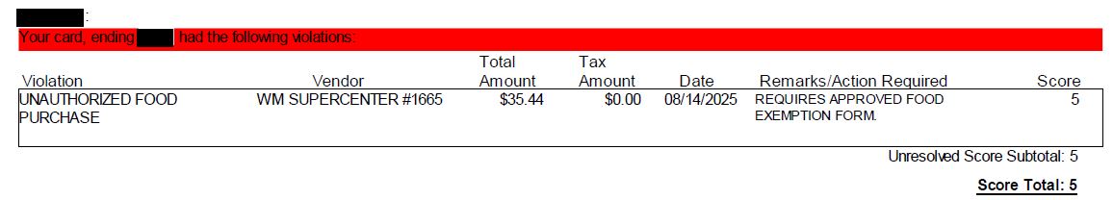
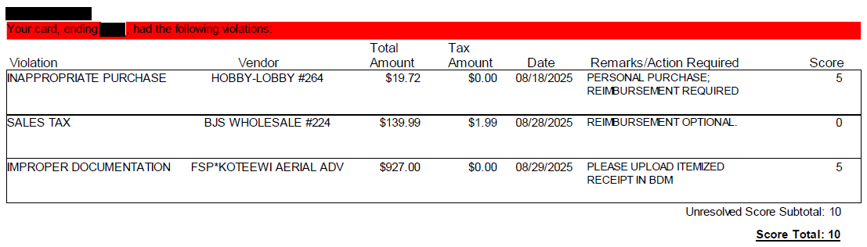
EXAMPLES OF VIOLATION NOTIFICATIONS (1 OF 2)
Purchasing Card Audits & BDM 2025
Office of Accounts Payable

Slide 26
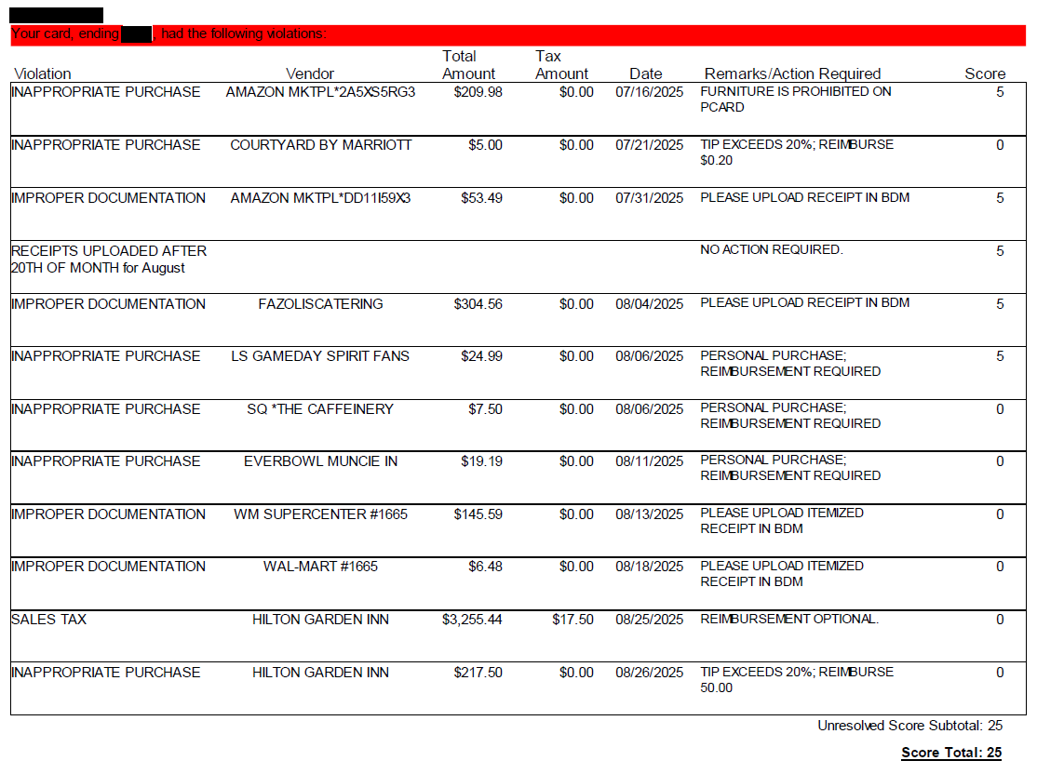
EXAMPLES OF VIOLATION NOTIFICATIONS (2 OF 2)
Purchasing Card Audits & BDM 2025
Office of Accounts Payable

